Slide 1
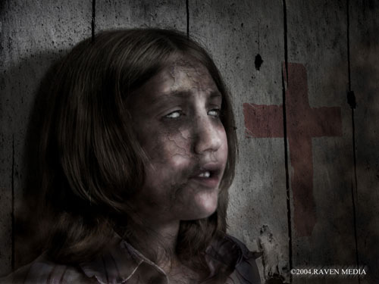

Slide 2
“People ate lunch with their friends and dinner with their ancestors in paradise.” -Richard Wellington, London, 1352

Slide 3
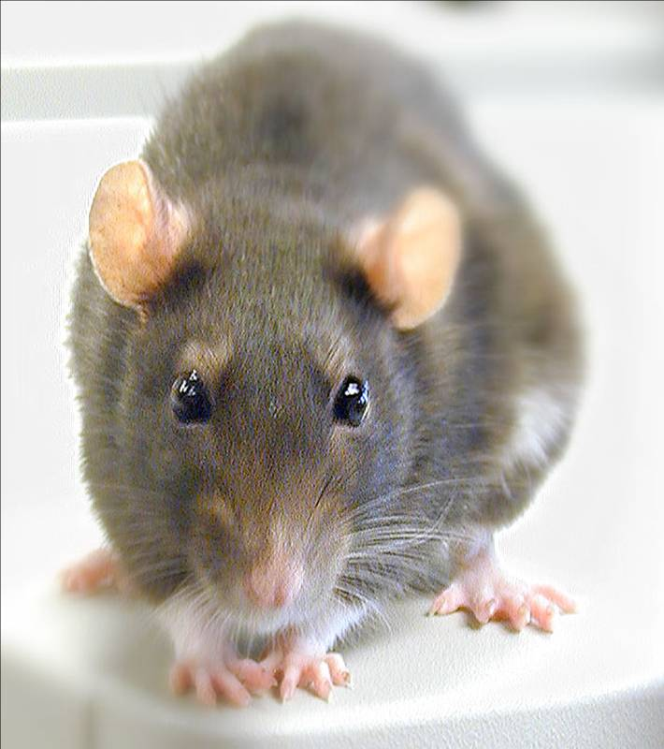
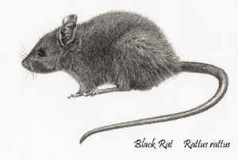
The Black Death

Slide 4
The Beginning of the Plague
Bubonic Plague: very aggressive epidemic that spreads very quickly
The Plague reaches Europe
It came from China on Italian Trading Ships

Slide 5
How it Spread
Rats carried bacteria (Y.Pestis) in their blood
Fleas drank the blood
Fleas bit humans
Humans died
Why It Spread
-Very Dirty
-Poor Sanitation
-Perfect spot for rats

Slide 6
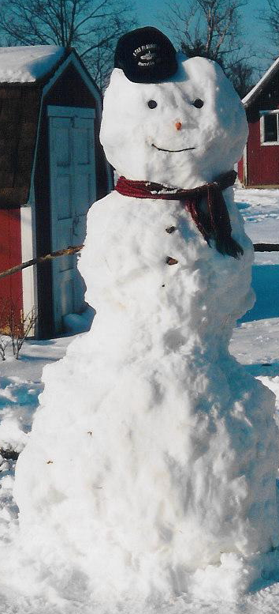
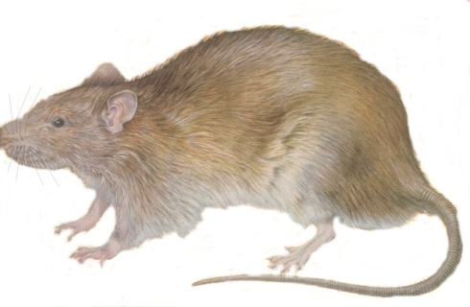
The Plague in Europe
The Bubonic Plague Tricks the people of Europe:
*During the winter, the plague
appeared as if it had stopped……
NOT TRUE!
*The plague is Seasonal.
What does that mean?

Slide 7
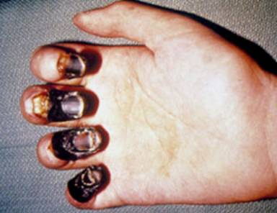
The Black Death
Bubonic Plague nicknamed “Black Death”
--limbs, fingers, spots on body turn black.

Slide 8
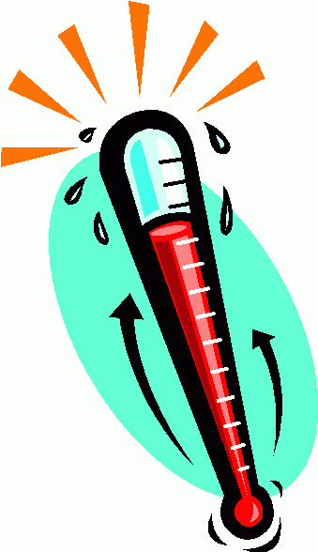
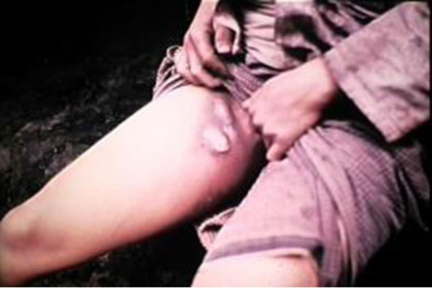
Symptoms of the Black Death
*Fever
*Painful swelling of lymph glands
*spots on skin that turn red, then black

Slide 9
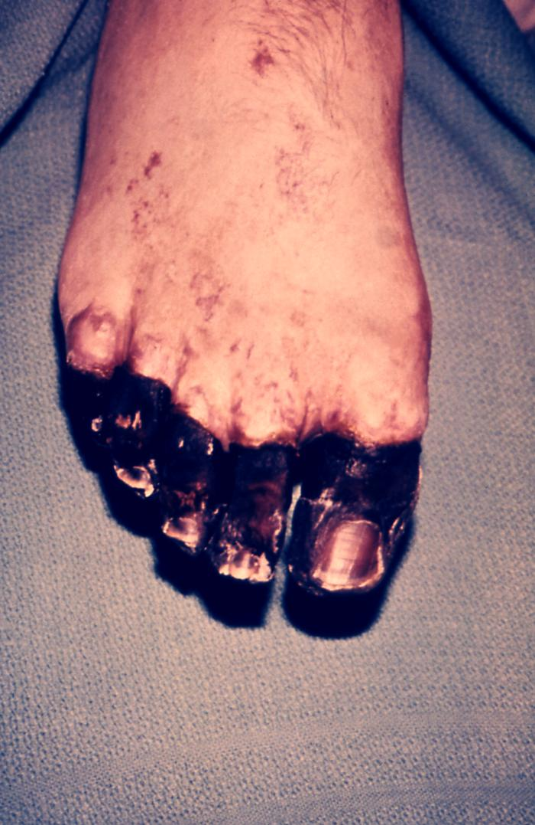
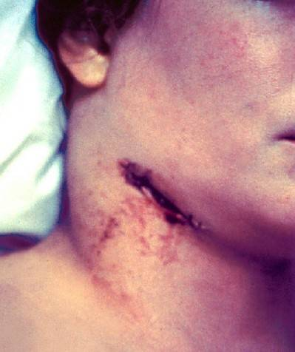
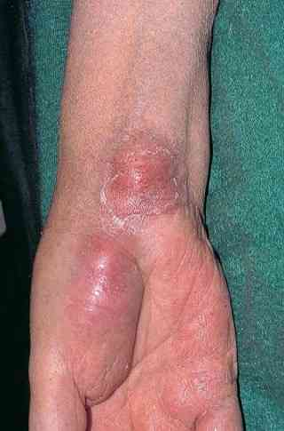
Appearance of Plague

Slide 10
The Black Death affects Society
European Society never recovered **33% population loss in Europe**
25 Million People in 5 Years!!!
*shortage of labor
*people starve
*people Question the church
*towns disappear

Slide 11
People Terrified
NO Contact: Doctors/priests would stay away from people: afraid of getting sick
People didn’t know the cause of all these deaths
People thought they could get it just by looking at someone with the plague

Slide 12
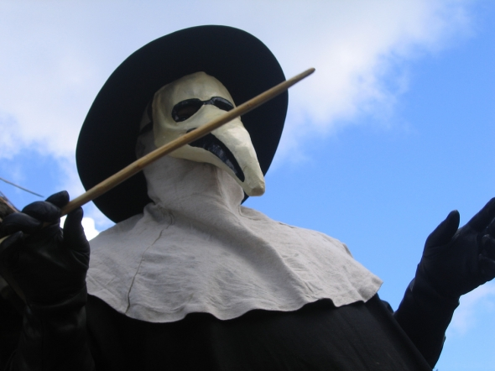

Slide 13
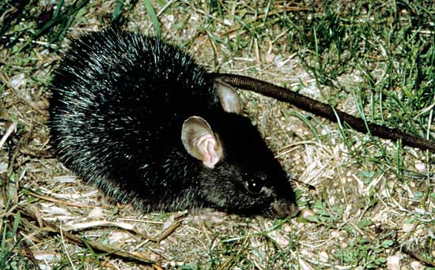
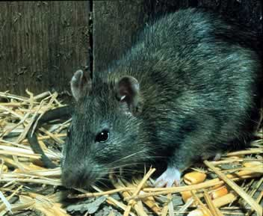
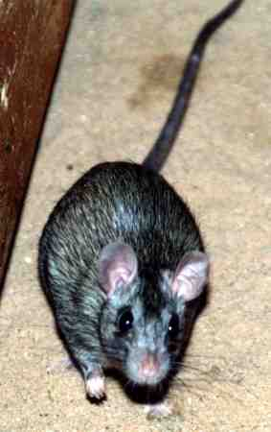
The cause…

Slide 14
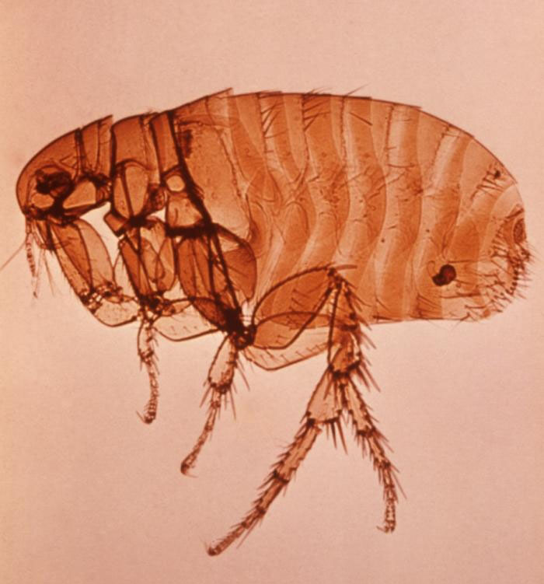

Slide 15
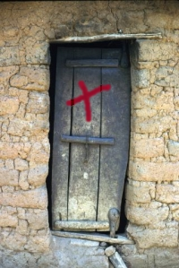

Slide 16
Image symbolizing the Black Death

Slide 17
Figure it Out
How many people would be left in each place if the Plague hit? (hint: 33% of population died in Europe due to the Plague)
-South Dakota: pop. = 700,000
-Milbank: pop. = 4,000
-6th grade: pop. = 51

