Slide 1
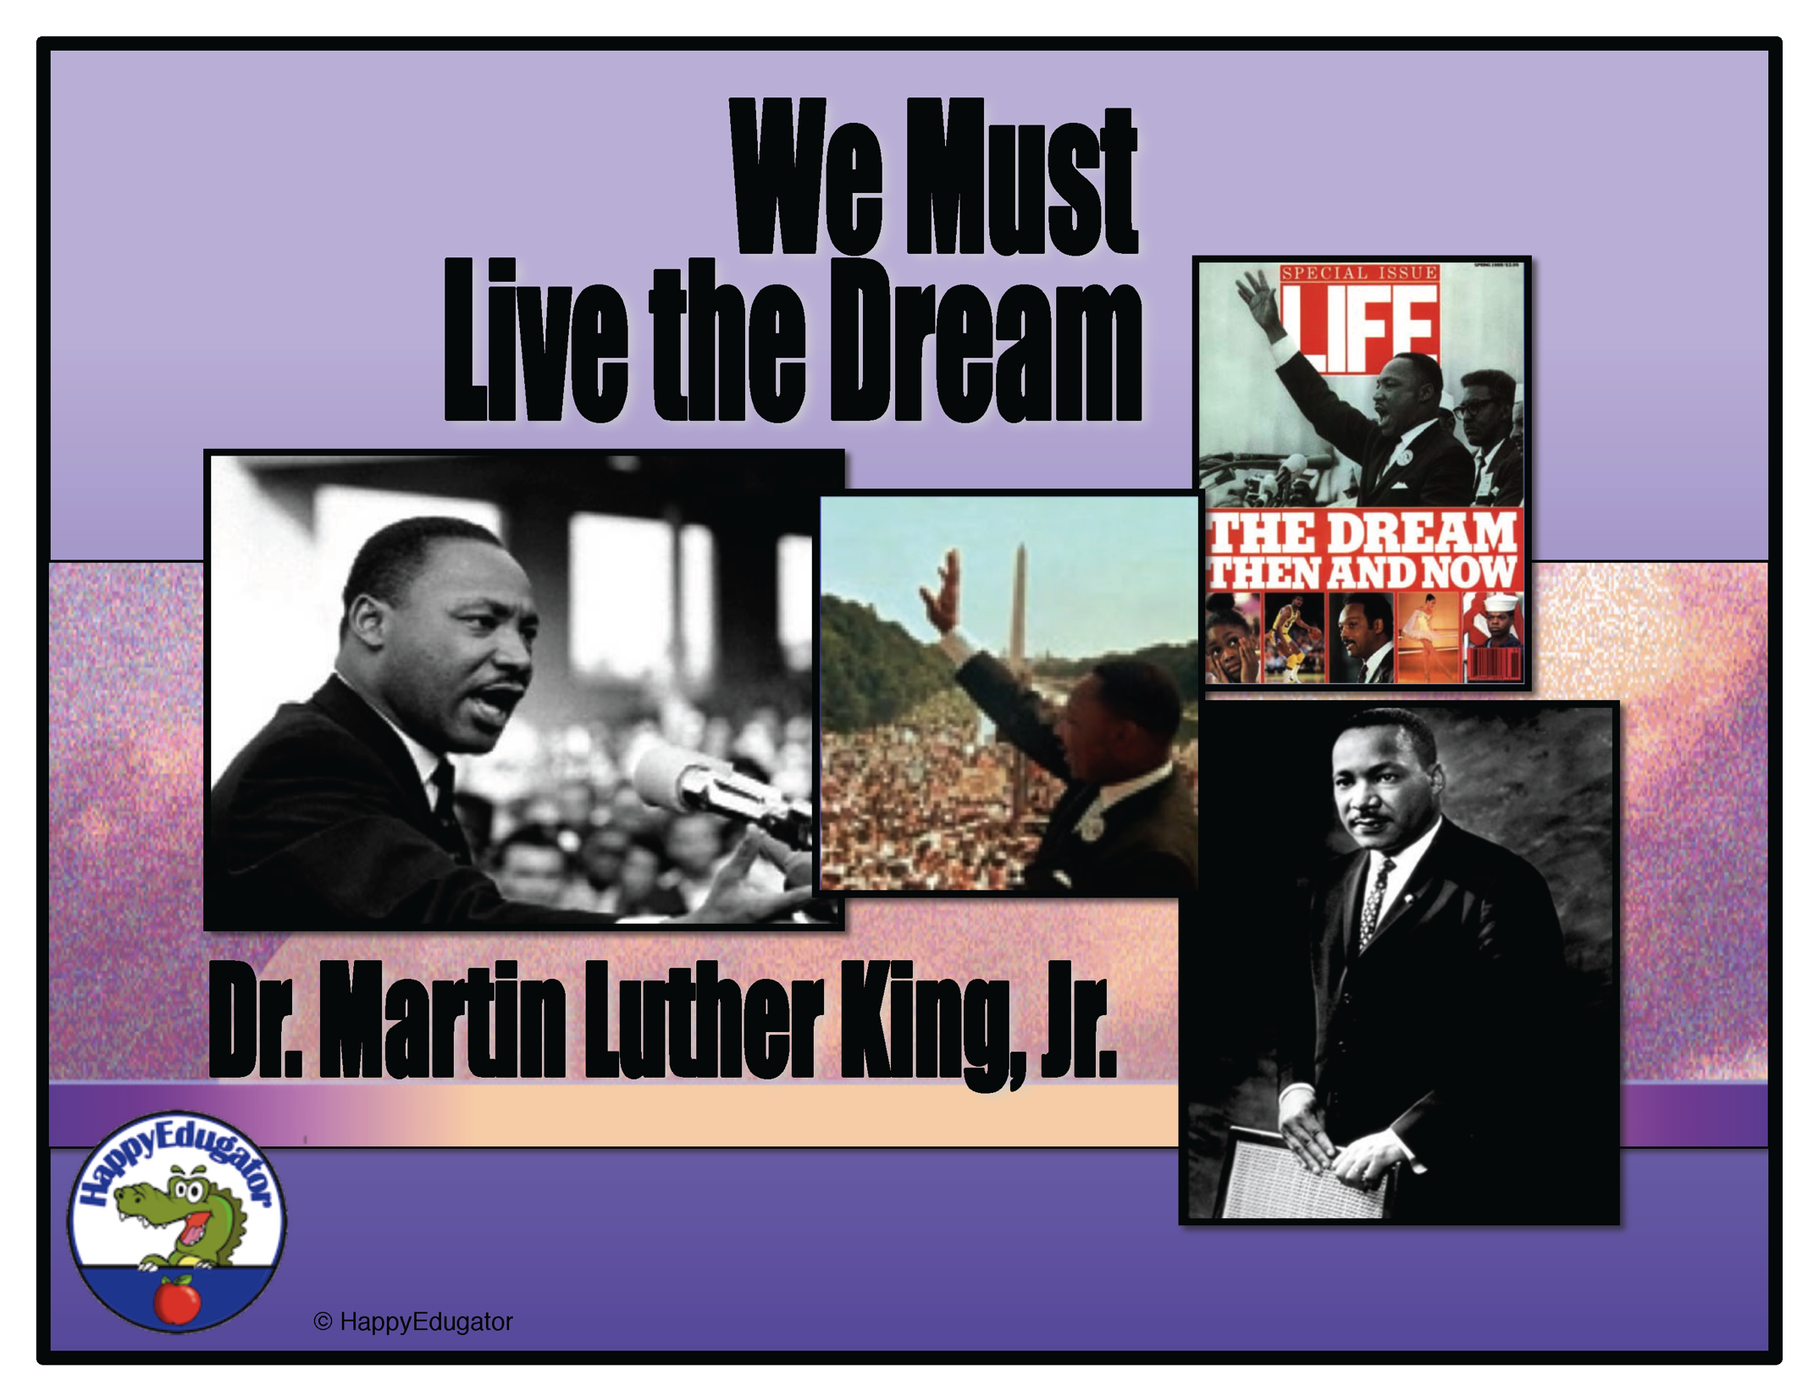

Slide 2
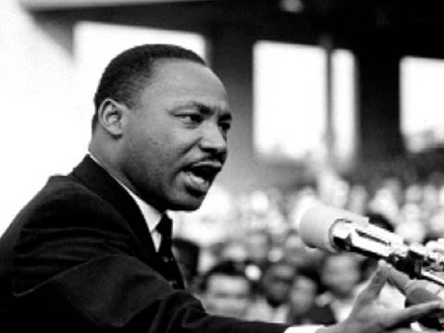
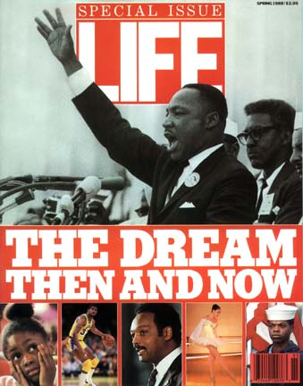
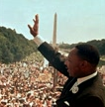
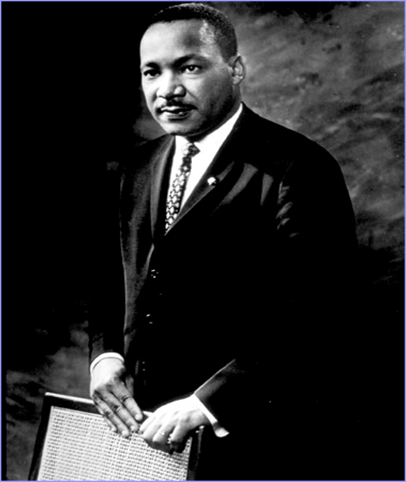
Dr. Martin Luther King Jr.
We Must Live The Dream

Slide 3
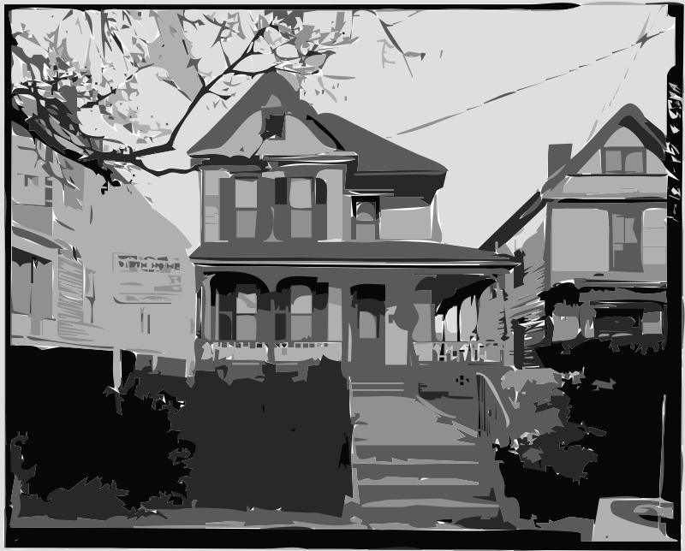

Atlanta
1929
In the beginning…
Michael Luther King, Jr. was born on January 15,1929, to a schoolteacher, Alberta King, and a Baptist minister, Michael Luther King. They lived at 501 Auburn Avenue, Atlanta, GA.

Slide 4
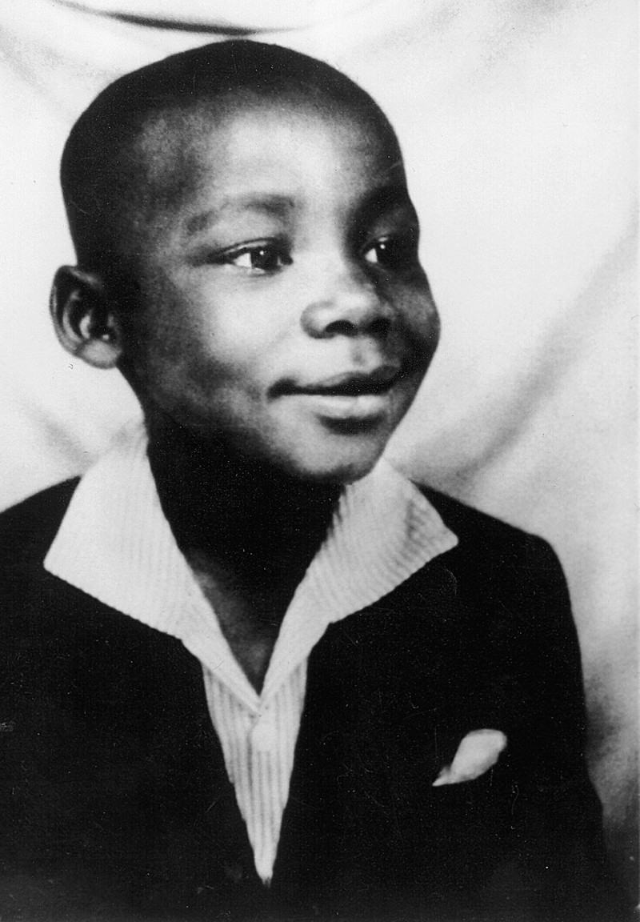
Early years…
After a trip to Germany in the 1930’s, his father changed both their names to Martin Luther King, in honor of the priest who started the Protestant Reformation of the church. His family continued to call him Mike or M.L.

Slide 5

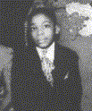
Early years…
Martin Luther King, Jr. grew up in the church and was raised in the Christian scripture. Following the family tradition, he decided to become a minister.

Slide 6
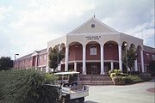
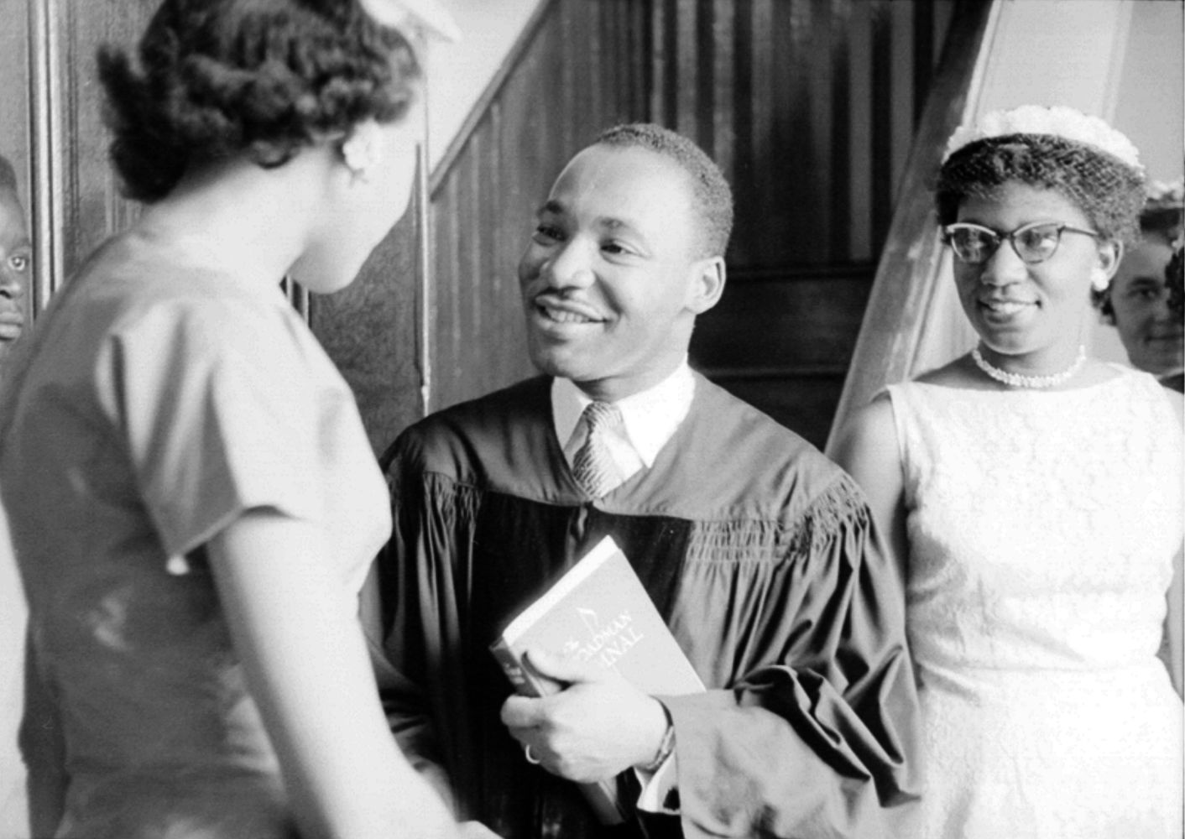
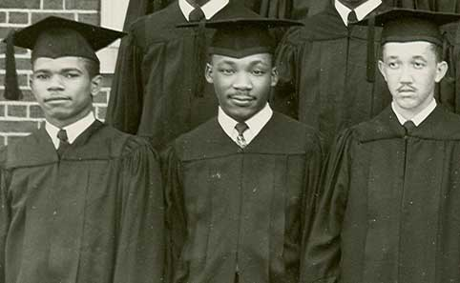
Growing Up…
He did well in school. King was admitted into Morehouse College at the age of only 15 and graduated in 1948 with a Bachelor of Arts degree in Sociology at the age of 19.

Slide 7
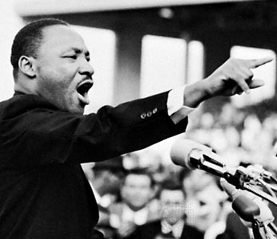
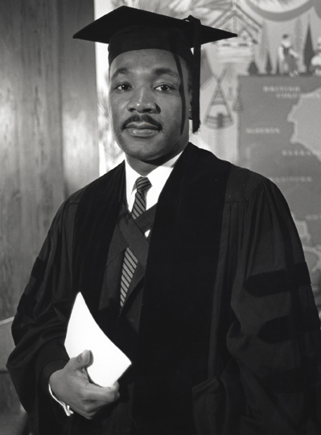
1948:
Graduates from Morehouse College

Slide 8
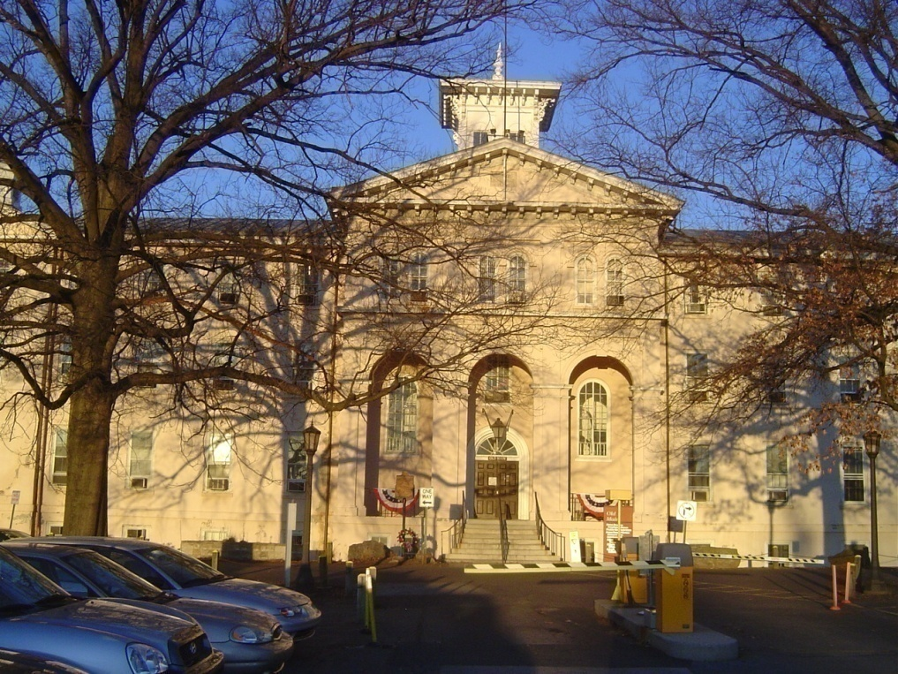
King enrolled in Crozer Theological Seminary in Chester, Pennsylvania and he graduated with a Bachelor of Divinity degree in 1951.

Slide 9
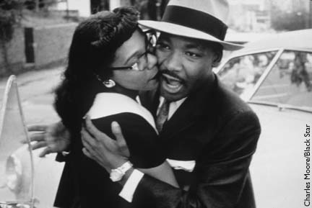
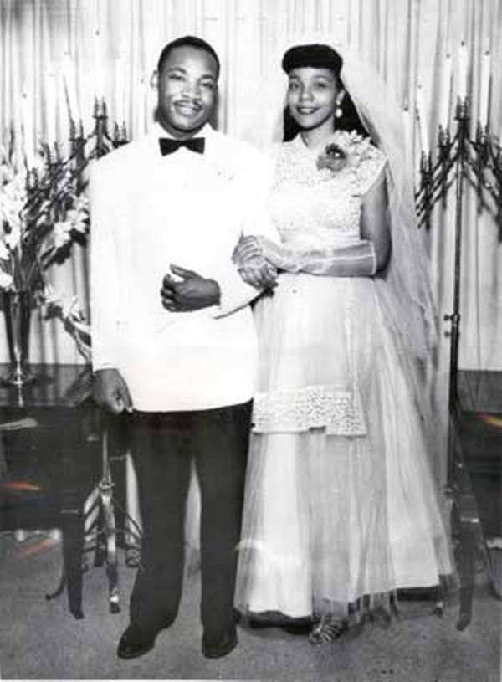
Marriage…
King met Coretta in Boston while she was studying music there, and they announced their engagement on Valentines Day. King married Coretta Scott in Marion, Georgia on June 18, 1953, on her parents' front lawn.

Slide 10
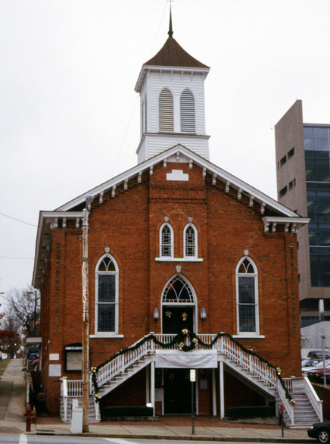
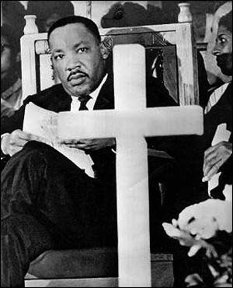

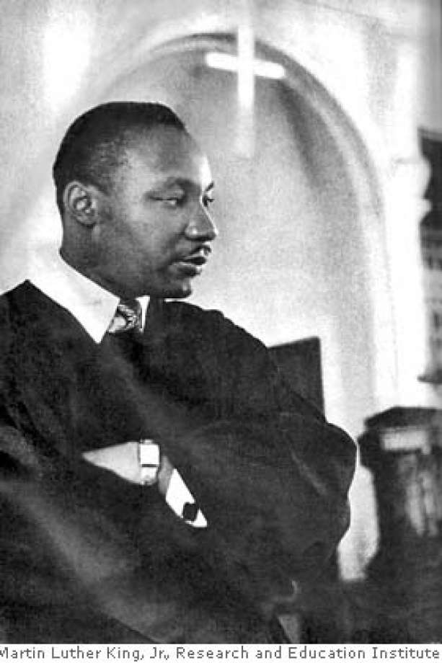
Pastor…
King began his ministry in 1954 as the pastor of Dexter Avenue Baptist Church in Montgomery, Alabama.

Slide 11
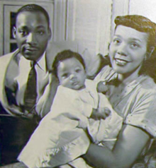
Yolanda is Born
Family Life…
After Martin became pastor of the church, Coretta sang in the choir and taught Sunday school. On November 7, 1955, they welcomed their first child into the world…Yolanda Denise King.

Slide 12
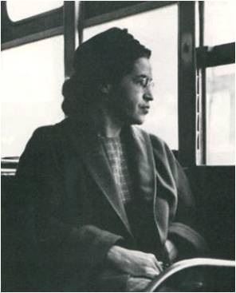
Civil Rights
Movement…
On December 1, 1955, Rosa Parks took a stand for her race by refusing to give up her seat to a white passenger. In those days, city buses were segregated. This marked the beginning of the Civil Rights Movement. Following this event, King was selected as President of the Montgomery Improvement Association.
ROSA PARKS,
a woman of courage.

Slide 13
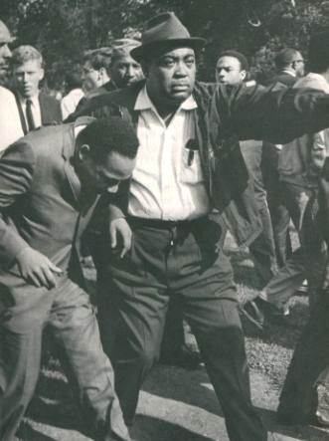
1956: After a boycott of the buses, the
District court rules bus segregation is unconstitutional.
Changing
Times…

Slide 14
Peaceful Protest
Violent Attacks
After becoming involved with the Montgomery Bus Boycott, the family began receiving threatening phone calls. On December 23, 1956, a gunshot was fired into their home while they were asleep. No one was hurt. Coretta took the baby to Atlanta to her parents’ house, and he followed later. They went back to Montgomery in February the next year.

Slide 15
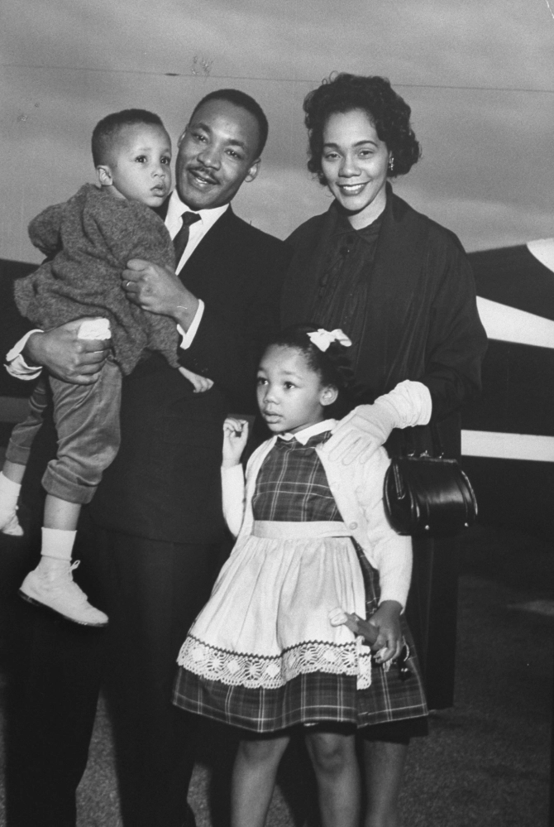
1957
Martin Luther III was born.
His mother was concerned about naming him after his father, because she didn’t want him to suffer any persecution for it.

Slide 16
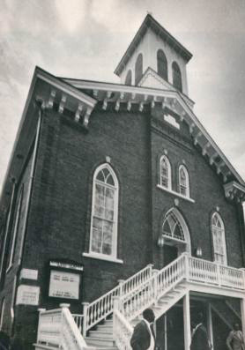
1958: King’s book, “Stride Toward Freedom: The Montgomery Story” is published.
Author…
He is stabbed at a book signing in Atlanta.

Slide 17

More Worries…
The threats continue, and the Kings house is firebombed. Yet they continue their belief in peaceful protest as the biblical way to handle the situation.

Slide 18
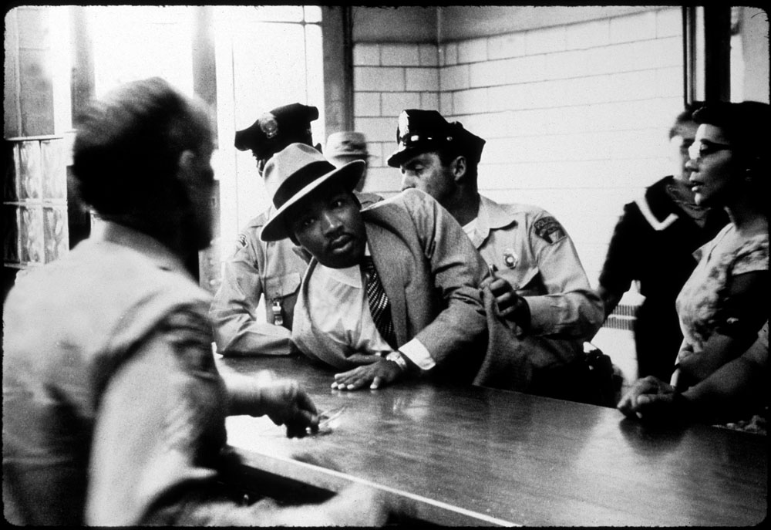
Dr. King is Arrested
Tensions are high…
Once for loitering,
and then for driving on an Alabama license in Georgia.

Slide 19
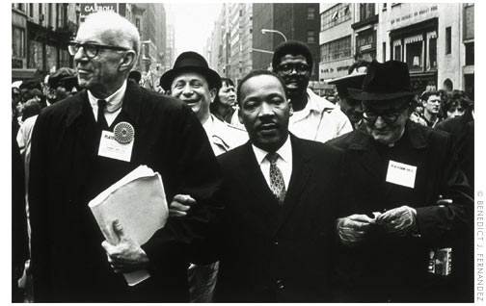
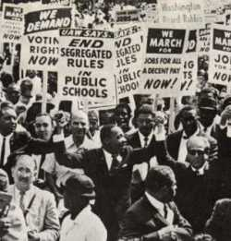
Dr. King Marches for Civil Rights
Leader of Peaceful Protest
The Civil Rights Movement was in full swing. Peaceful protests all over the country demanded voting rights and an end to segregation laws.

Slide 20
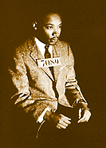
“We Shall Overcome”
Peaceful Protests Continue
Click the picture below to hear the song that defined the Civil Rights Movement.
We shall overcome,
We shall overcome,
We shall overcome some day.
Oh, deep in my heart (I know that)
I do believe: We shall overcome some day.
We’ll walk hand in hand.
We shall live in peace.
We are not afraid
We shall all be free.
We are not alone.

Slide 21
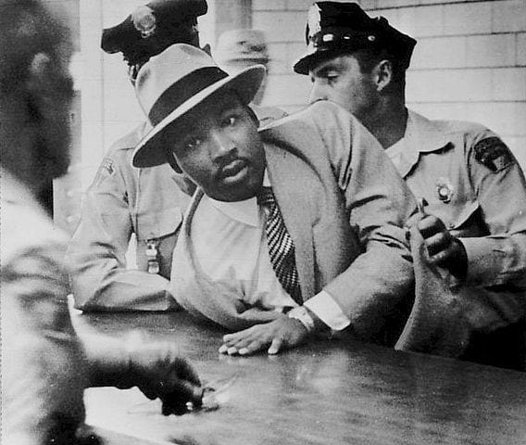
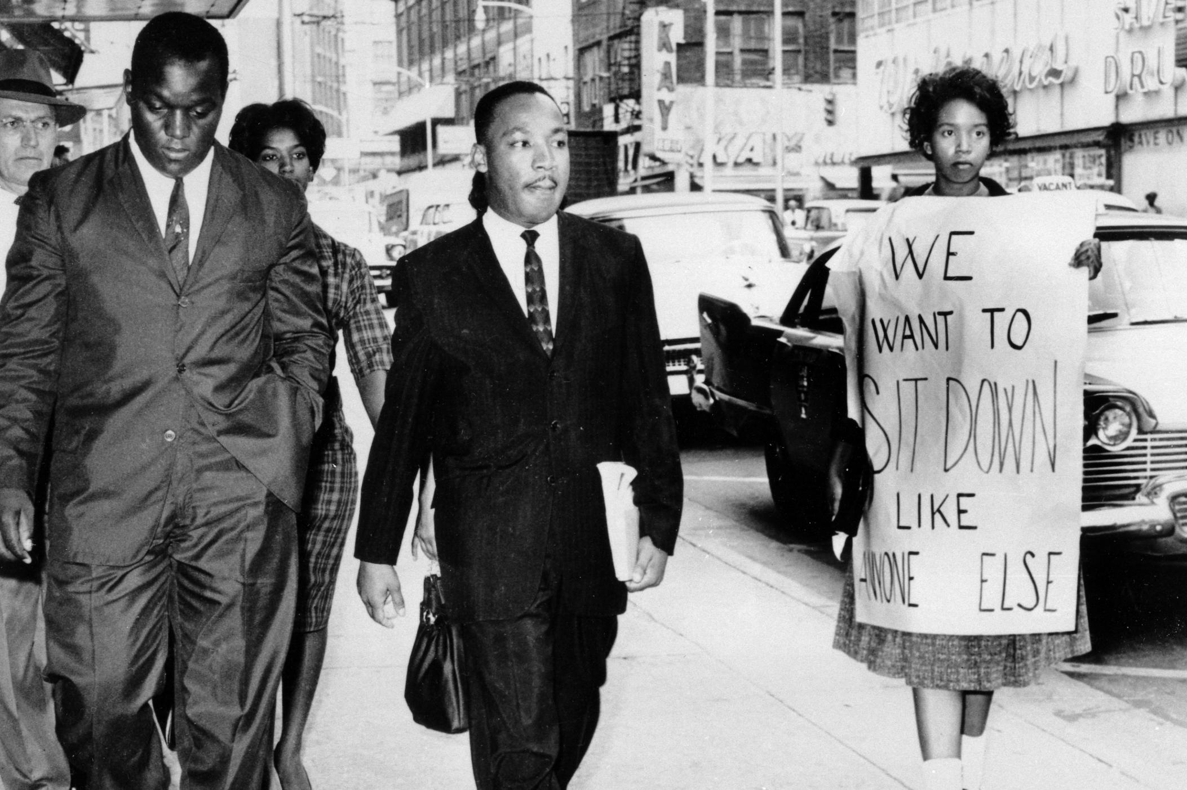
Dr. King is arrested during a peaceful lunch counter sit-in.
In 1960, King was arrested for participating in a lunch counter sit-in in Atlanta, Georgia and sentenced to four months of hard labor on a chain gang.

Slide 22
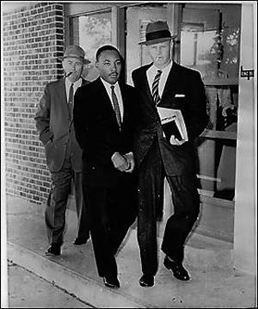

John F. Kennedy
phoned Coretta
Presidential candidate John F. Kennedy heard the news about the imprisonment and called Coretta to offer her comfort and sympathy. Coretta told him she was afraid for his life in prison. Martin received strong encouragement as a result of this telephone call to Coretta from John F. Kennedy.
John F. Kennedy

Slide 23

Release from prison…
Sometime later, Senator Bobby Kennedy, JFK’s brother, was able to obtain Martin Luther King’s release from prison. Coretta was expecting another child at the time.
Bobby Kennedy

Slide 24
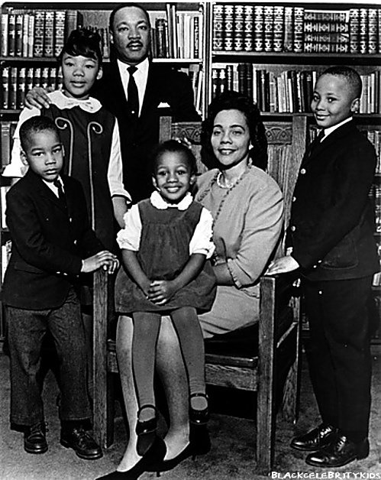
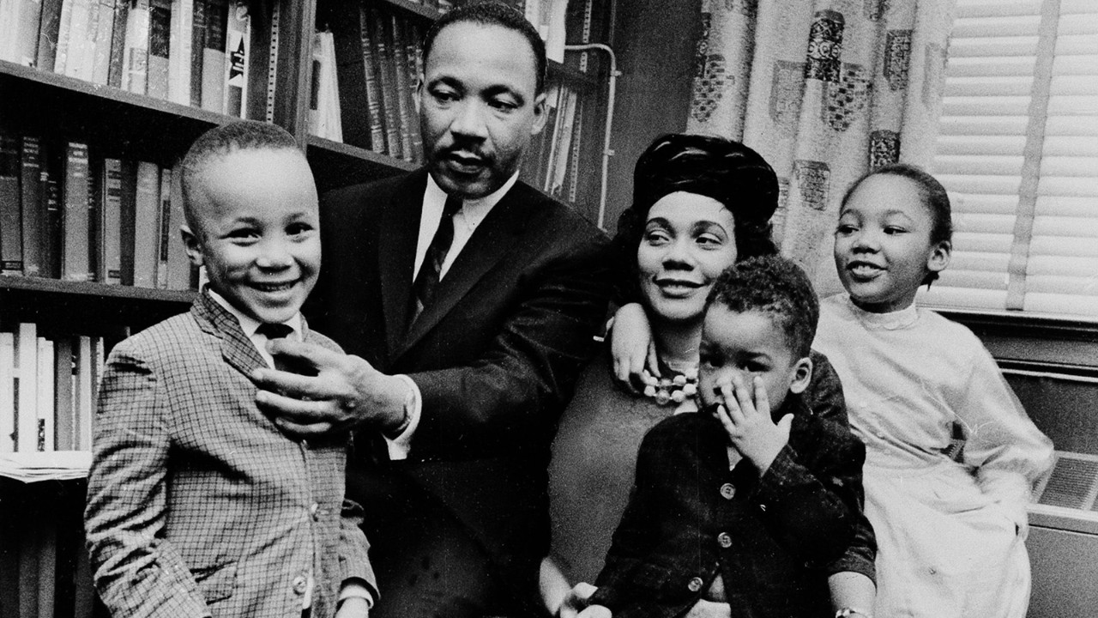
Martin Luther King, Jr. and Family,
1963

Slide 25
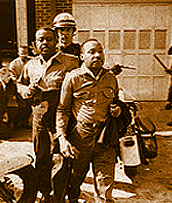
“Letter from Birmingham Jail”
Makes an impact.
1963
From the Birmingham jail, where he was imprisoned for his involvement in nonviolent marches against segregation, Dr. Martin Luther King, Jr., wrote an open letter saying that people have a moral responsibility to break unjust laws and to take direct action rather than waiting possibly forever for justice to come through the courts. “Injustice anywhere is a threat to justice everywhere.”

Slide 26
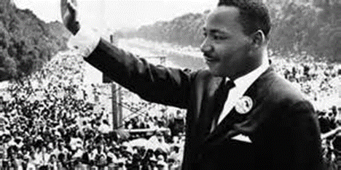
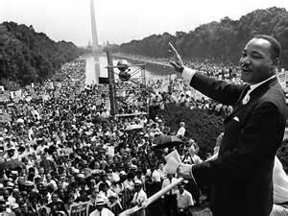
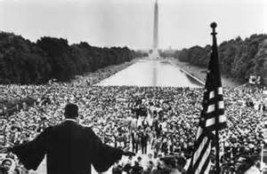
Leading the people…
Dr. King spoke to 250,000 civil rights supporters during the “March on Washington” August 28, 1963, for jobs and freedom. This march was in support of the Civil Rights Act. His words resounded in hearts around the world.

Slide 27
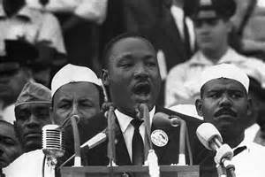
Dr. King made his famous “I Have a Dream” speech.

Slide 28
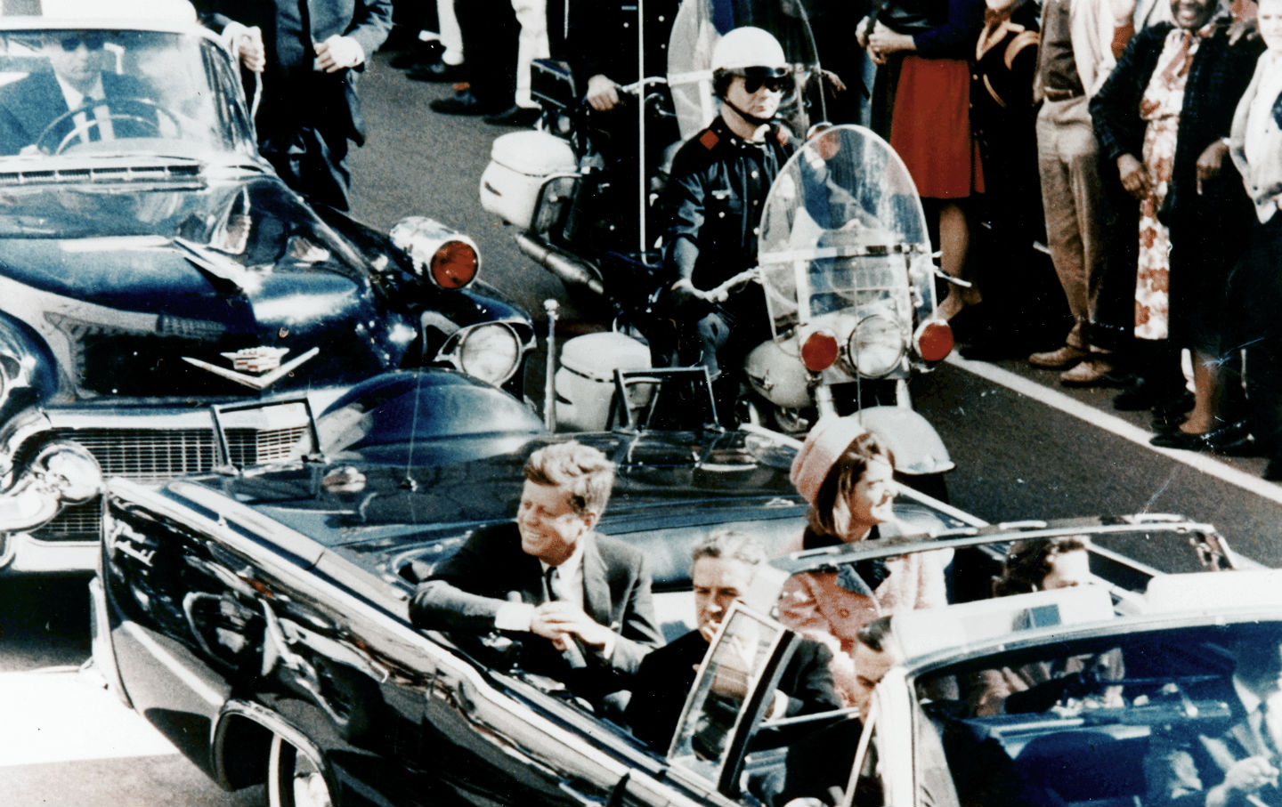
President John F. Kennedy is Assassinated,
1963
November 23,1963 President Kennedy is shot while riding in his motorcade in Dallas, Texas.

Slide 29
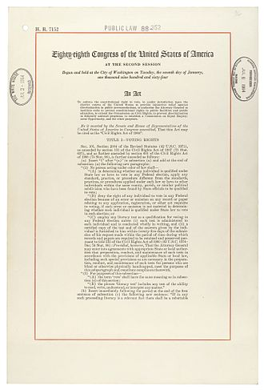
1964:
The Civil Rights Act
This was a landmark civil rights and labor law in the United States that outlawed discrimination based on race, color, religion, sex, national origin, and later sexual orientation and gender identity. It prohibits unequal application of voter registration requirements, racial segregation in schools and public places, and employment discrimination. The act "remains one of the most significant legislative achievements in American history".

Slide 30
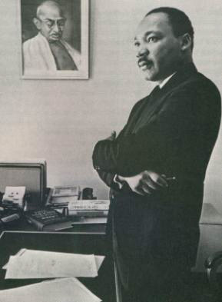
1964:
Nobel Peace Prize
Winner

Slide 31
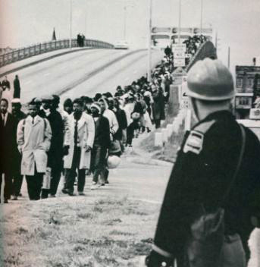
Freedom Marches…
Selma to Montgomery, Alabama
1965
Three marches were made to protest the blocking of Black Americans' right to vote by the Jim Crow South. Many marchers were injured by law enforcement, but they led to the passing of the Voting Rights Act of 1965.

Slide 32
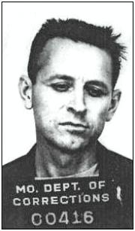
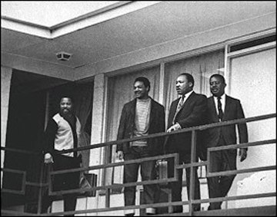
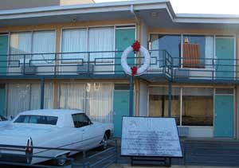
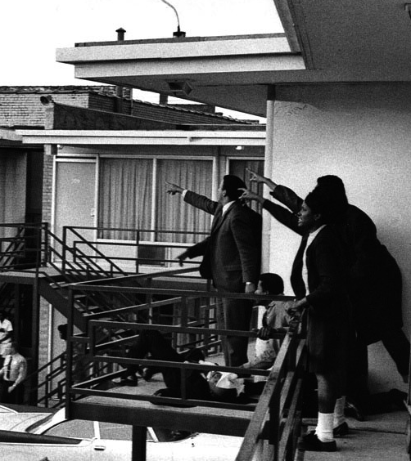
On April 4, 1968, while standing on a balcony at the Lorraine Motel in Memphis, Tennessee, King was assassinated by James Earl Ray.

Slide 33
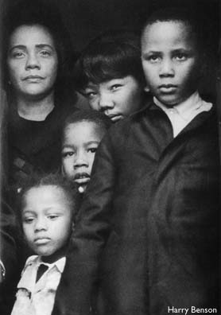
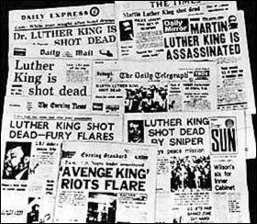
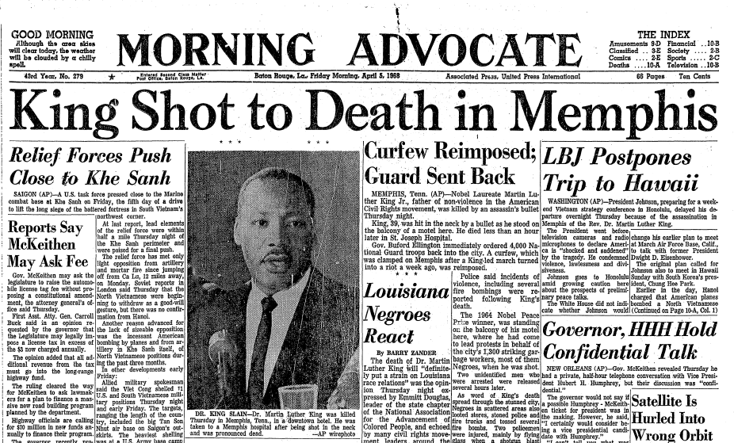
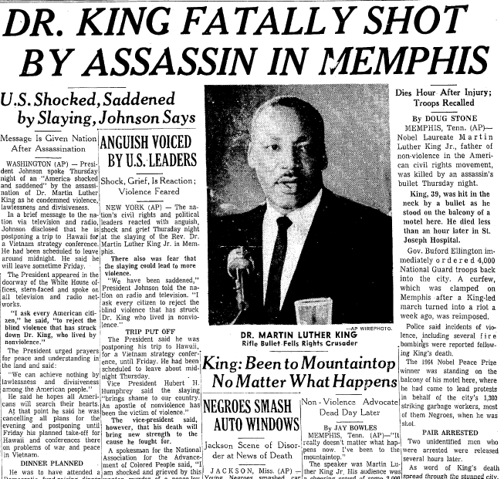

Coretta and his children mourn, along with the nation

Slide 34


April 19, 1968
Dr. King’s funeral is an international event.

Slide 35




Funeral…
The entire country, along with Coretta and his four children, mourned his death.

Slide 36

Memorial…
Dr. Martin Luther King, Jr. is entombed at the Freedom Hall Complex. This site was listed as a National Historic Landmark on May 5, 1977 and was made a National Historic Site on October 10, 1980.

Slide 37









Timeline
1930 1940 1950 1960 1970 1980 1990 2000

Slide 38


November 2, 1986
President Reagan signed the bill making January 20th a national holiday in King’s honor.
Celebrating His Life

Slide 39

Live the dream
TODAY!!!
Kindness
Tolerance
Equality
Togetherness
Non-violence
Peace
Diversity
Pride in ONESELF

Slide 40

Free At Last
Jan. 15, 1929- April 4, 1968

Slide 41
Writing Assignment
The next four slides are four different options for writing response. Make sure when you write your response, you support your answer using evidence from what you have read.

Slide 42

Option 1
Your Response:
“Your Dream for the Future”
Choose what you believe to be the most important problem(s) facing students at our school and describe these problems.
Explain why each of these problems are important to students and to the school as a whole
Suggest at least one solution for each of these problems. These suggestions may be creative, but realistic.
TEACHER OPTION - Present your solutions to the class or teacher.

Slide 43
Option 2
Your Response:
“Your Dream for the Future”
Choose what you believe to be the most important problem(s) facing your community and describe these problems.
Explain why each of these problems are important to your community and to the nation as a whole
Suggest at least one solution for each of these problem(s). These suggestions may be creative, but realistic.
TEACHER OPTION - Present your solutions to the class or teacher.

Slide 44
Option 3
Your Response:
“Your Dream for the Future”
Choose what you believe to be the most important problem(s) facing your nation and describe these problems.
Explain why each of these problems are important to your nation and to the world as a whole
Suggest at least one solution for each of these problem(s). These suggestions may be creative, but realistic.
TEACHER OPTION - Present your solutions to the class or teacher.

Slide 45
Option 4
Your Response:
“Your Dream for the Future”
Choose what you believe to be the most important problem(s) facing your family and describe these problems.
Explain why each of these problems are important to your family and to those close to you
Suggest at least one solution for each of these problem(s). These suggestions may be creative, but realistic.
TEACHER OPTION - Present your solutions to the class or teacher.

Slide 46


Martin Luther King Jr. PowerPoint and Writing Assignment
Thank you for downloading this resource. I hope that you enjoy and get a lot of use out of it. Please let me know if you have any questions or concerns. My email address is happyedug8r@msn.com
Commercial Graphics and fonts used with permission or license from Microsoft Design, GraphicStock.com, Pixabay.com and these artists:
Renee Goularte Creating Art With Kids
https://www.teacherspayteachers.com/Store/Renee-Goularte-Creating-Art-With-Kids
All the activities included in this product are the intellectual properties of Deborah Hayes, aka HappyEdugator. This resource is for classroom or homeschool use and is intended for the purchaser only. It may not be shared or distributed on the internet or posted on a public website without permission. It may be used in a virtual classroom online for distance learning and remote teaching on a password protected site such as Google Classroom. Additional licenses are needed for use in Outschool. This material is protected under the Digital Millennium Copyright Act.
Additional licenses are available at a discounted price.
© HappyEdugator
happyedug8r@msn.com

Slide 47




About Me
I have a Bachelor of Education in Elementary and a Master of Education for Middle Grades, both from the University of Florida. I am certified to teach all elementary and middle school grades in ELA, Math, Science, and Social Studies. I also have endorsements for Reading, Gifted Students, and Teacher Support Specialist. I started my Teachers Pay Teachers store in 2008 while teaching middle school full time. I have been working on TPT full time since 2014, when I moved to Washington State to be near my children and grandchildren.
Thank you for choosing my resources!
Find these related resources, and more, in my TPT store:
http://www.teacherspayteachers.com/Store/Happyedugator
Access digital Easel activities on product pages or in your My Purchases list.
Don’t forget! Leave me feedback to earn credits toward any future TPT purchases!
Follow my TPT store to get updates, freebies, and new resources:
https://www.teacherspayteachers.com/Sellers-Im-Following/Add/Happyedugator
I would love to have you follow me on Facebook or connect with me on social media:
Facebook: https://www.facebook.com/TheHappyEdugator/
Pinterest: https://www.pinterest.com/HappyEdugator/
Instagram: https://www.instagram.com/happyedugator/
Twitter: https://twitter.com/happyedug8r
Linked In: https://www.linkedin.com/in/happyedugator/
Thank you and happy teaching!
Deborah Hayes aka HappyEdugator
© 2022, 2012 HappyEdugator

