Slide 1
ISLAM

Slide 2
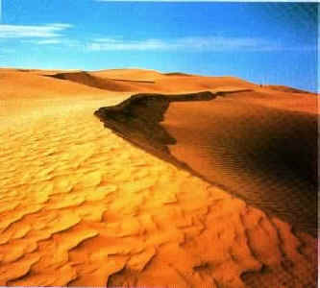
Birth of Islam
Muhammad “Praised One”
Born in Mecca
Went to Desert to pray
Angel spoke to him

Slide 3
Islam Grows
Muhammad preaches to public
Only one God
God requires people to submit or obey
Islam Today……
Arabic word for Submission: Islam
Believers: Muslims
Holy Book of Islam: Quran

Slide 4
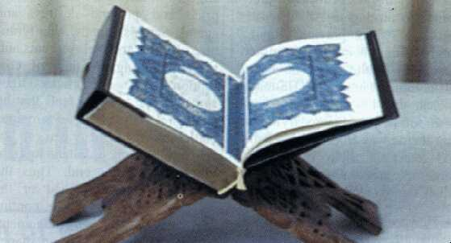
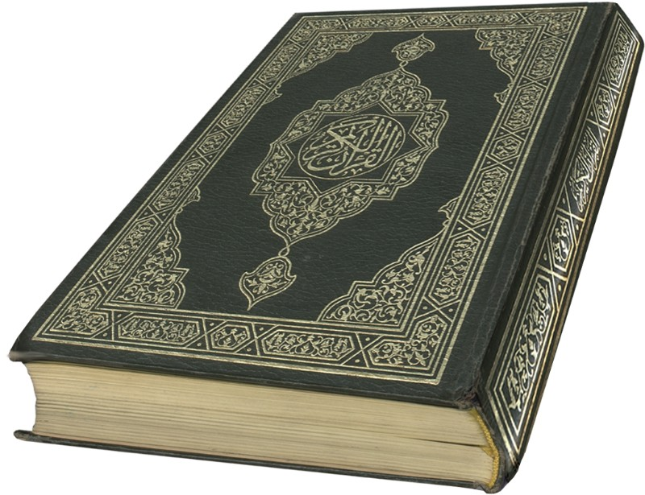
Quran

Slide 5
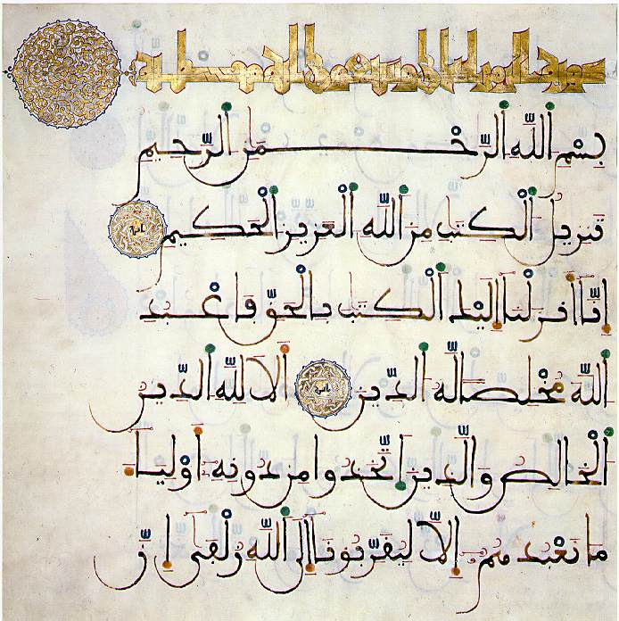

Slide 6
5 Pillars of Islam
“Shahada”
Profession of Faith.
There is no god but God and Muhammad is his prophet
Great Prophets: Abraham, Moses, and Jesus
**Different from Christianity?**

Slide 7
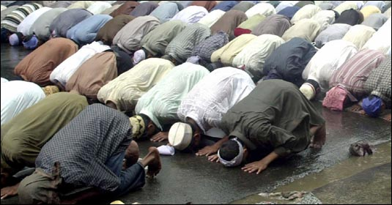
Second Pillar of Islam
“Salat”
**Five Daily prayers are generally offered in a group in a mosque
-Face direction of Mecca

Slide 8
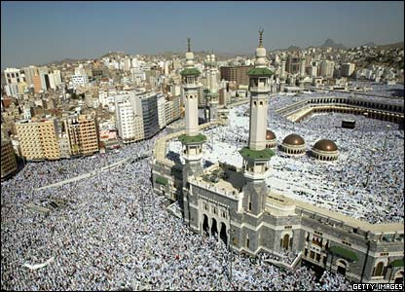
Mecca Picture Show

Slide 9
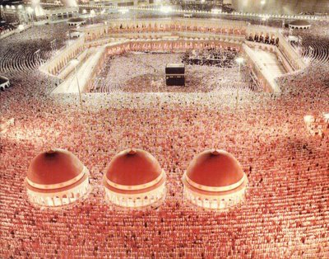

Slide 10
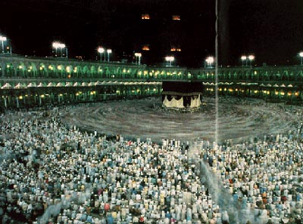

Slide 11
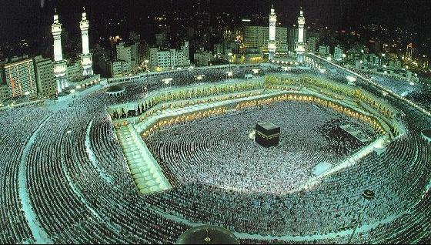

Slide 12
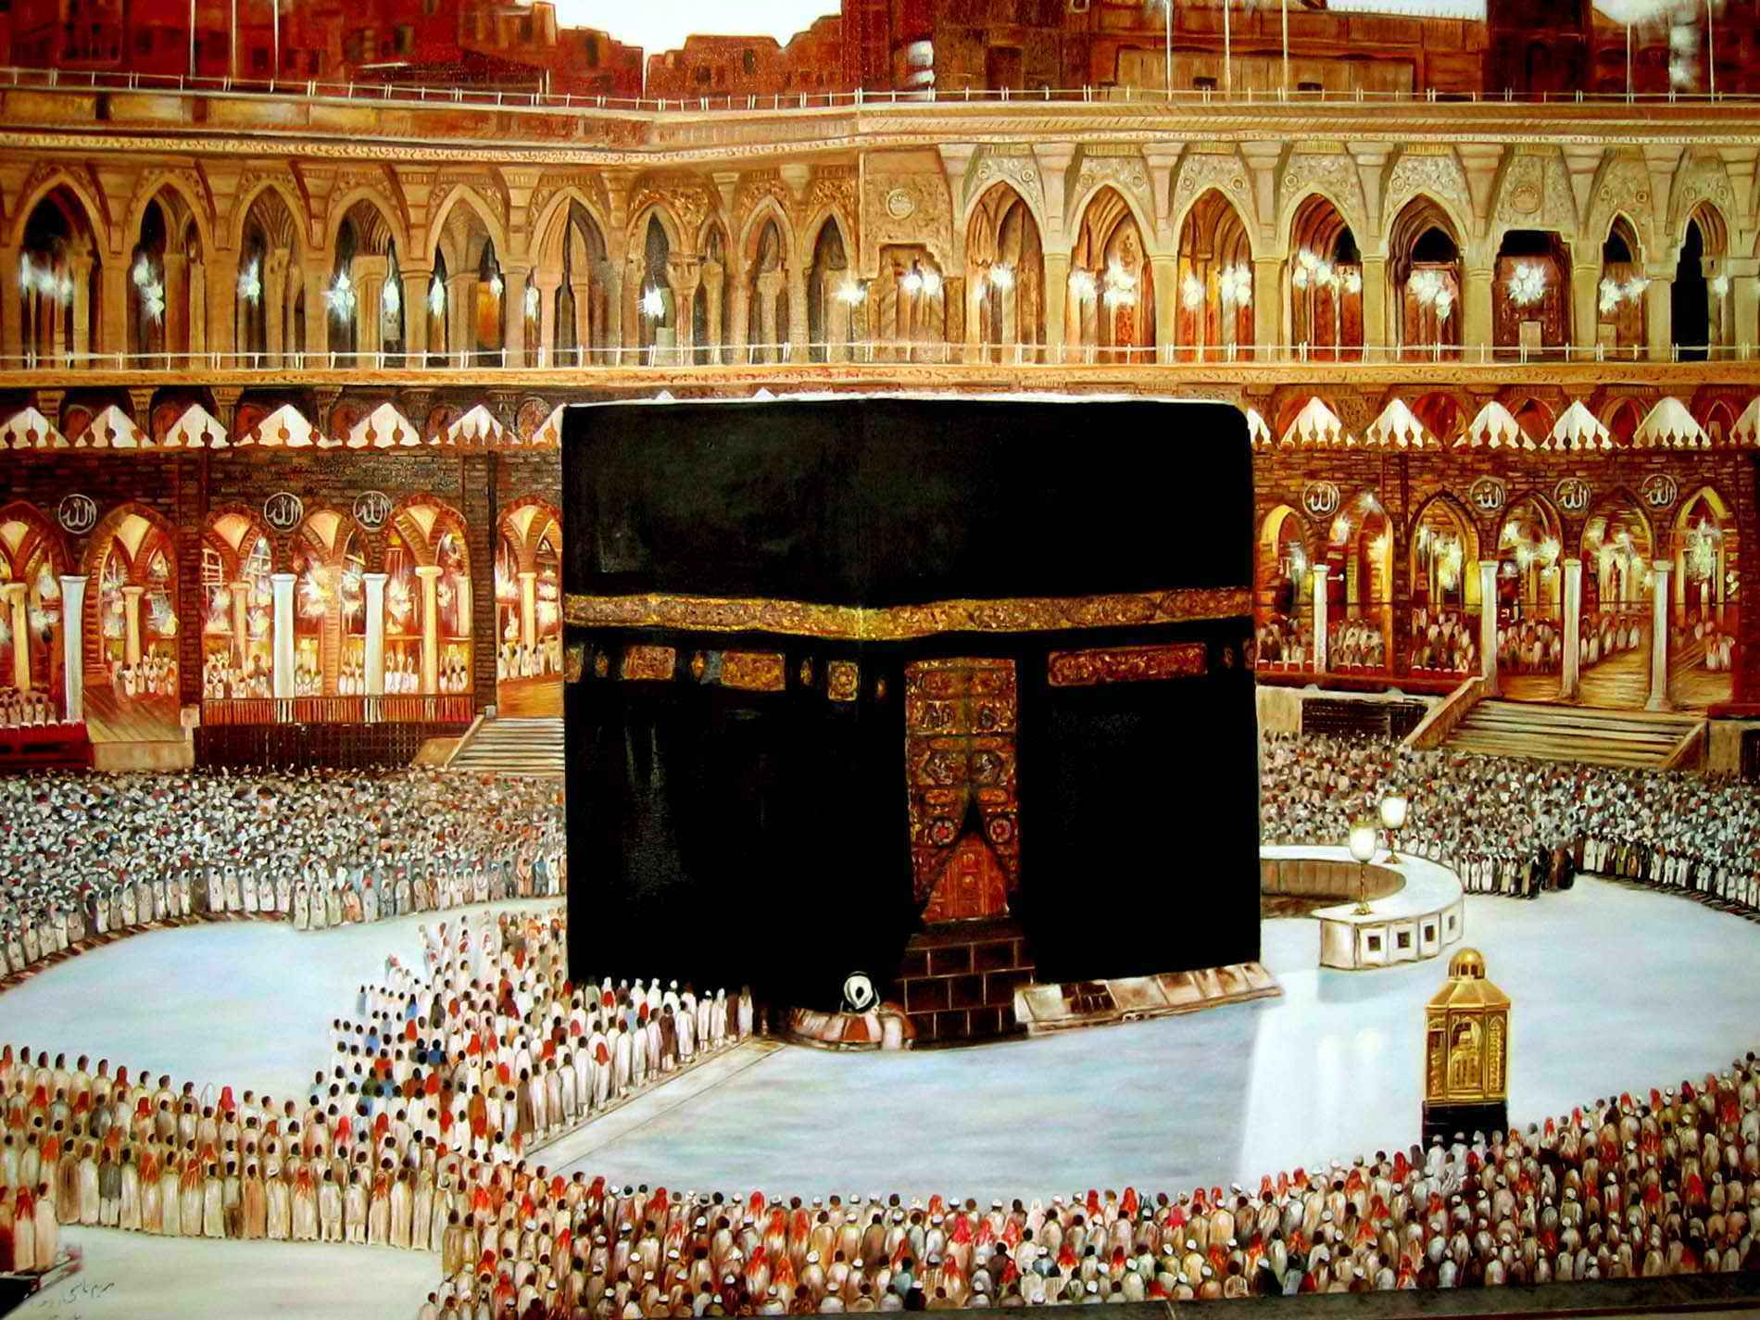
Ka’ba

Slide 13
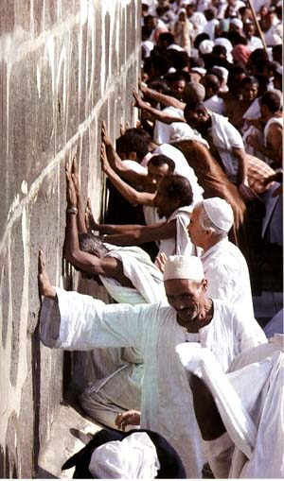

Slide 14
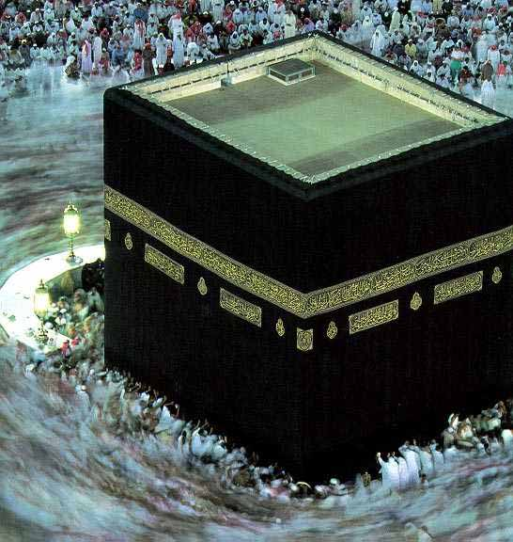

Slide 15
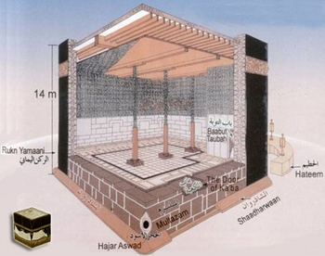

Slide 16
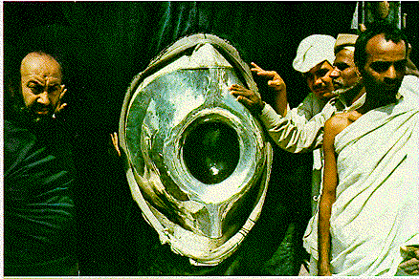

Slide 17
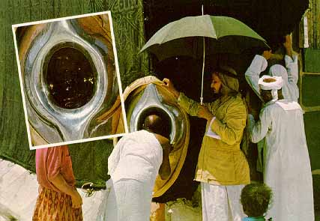

Slide 18
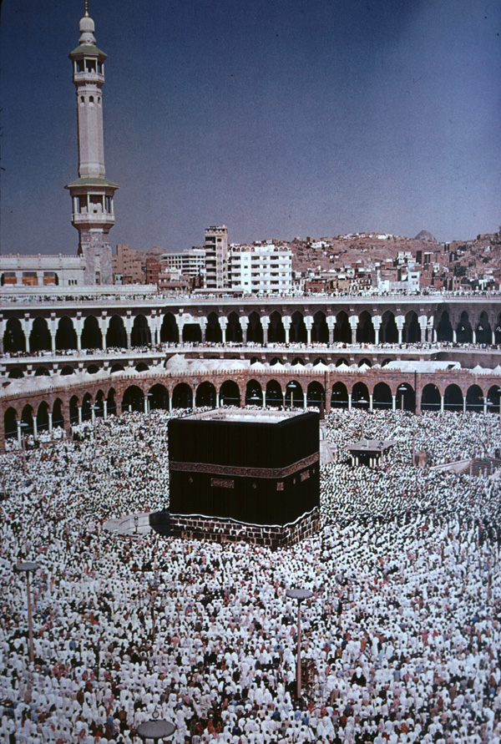

Slide 19
Third Pillar of Islam
“Sawn”
Give Charity to the poor.
Unite the Community

Slide 20
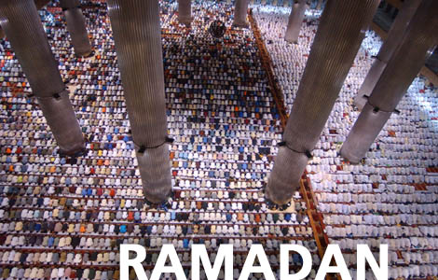
Fourth Pillar of Islam
“Zakat”
Fast during 9th month of Muslim Calendar
“Ramadan”
Daybreak to Sunset: eating/drinking forbidden

Slide 21
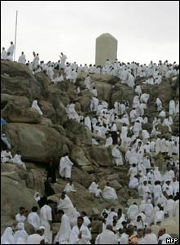
Fifth Pillar of Islam
“Hahij”
A pilgrimage must be made to Mecca
At least one time in your life.

Slide 22
Other things on Islam
Jihad: Religious duty in Islam.
“Struggle”
--Military or peaceful
Quran: Holy book. Outlines how to live
--No Pork or Alcohol
Mosque: Place of worship for Muslims

Slide 23
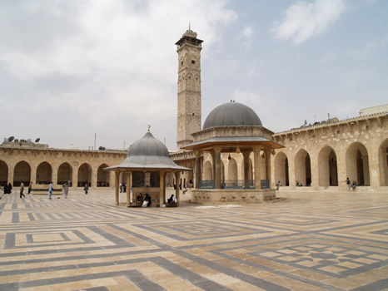
Mosque Picture Show

Slide 24
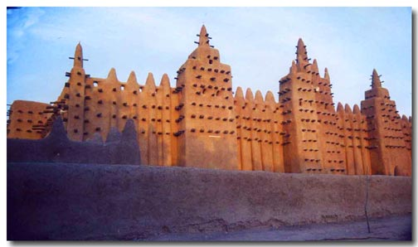

Slide 25
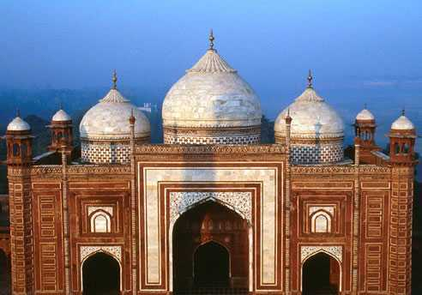

Slide 26
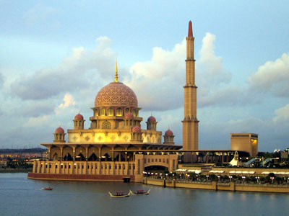

Slide 27
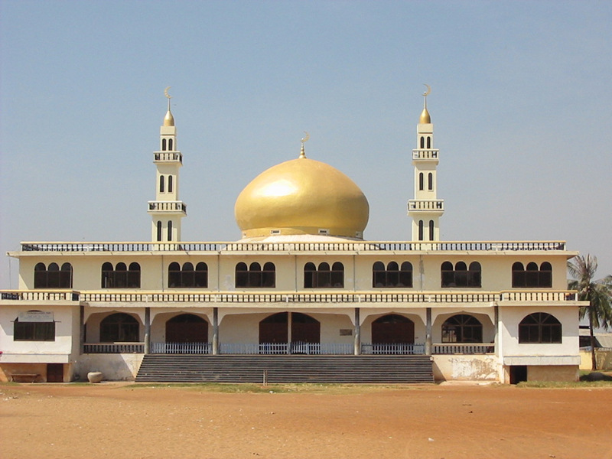

Slide 28
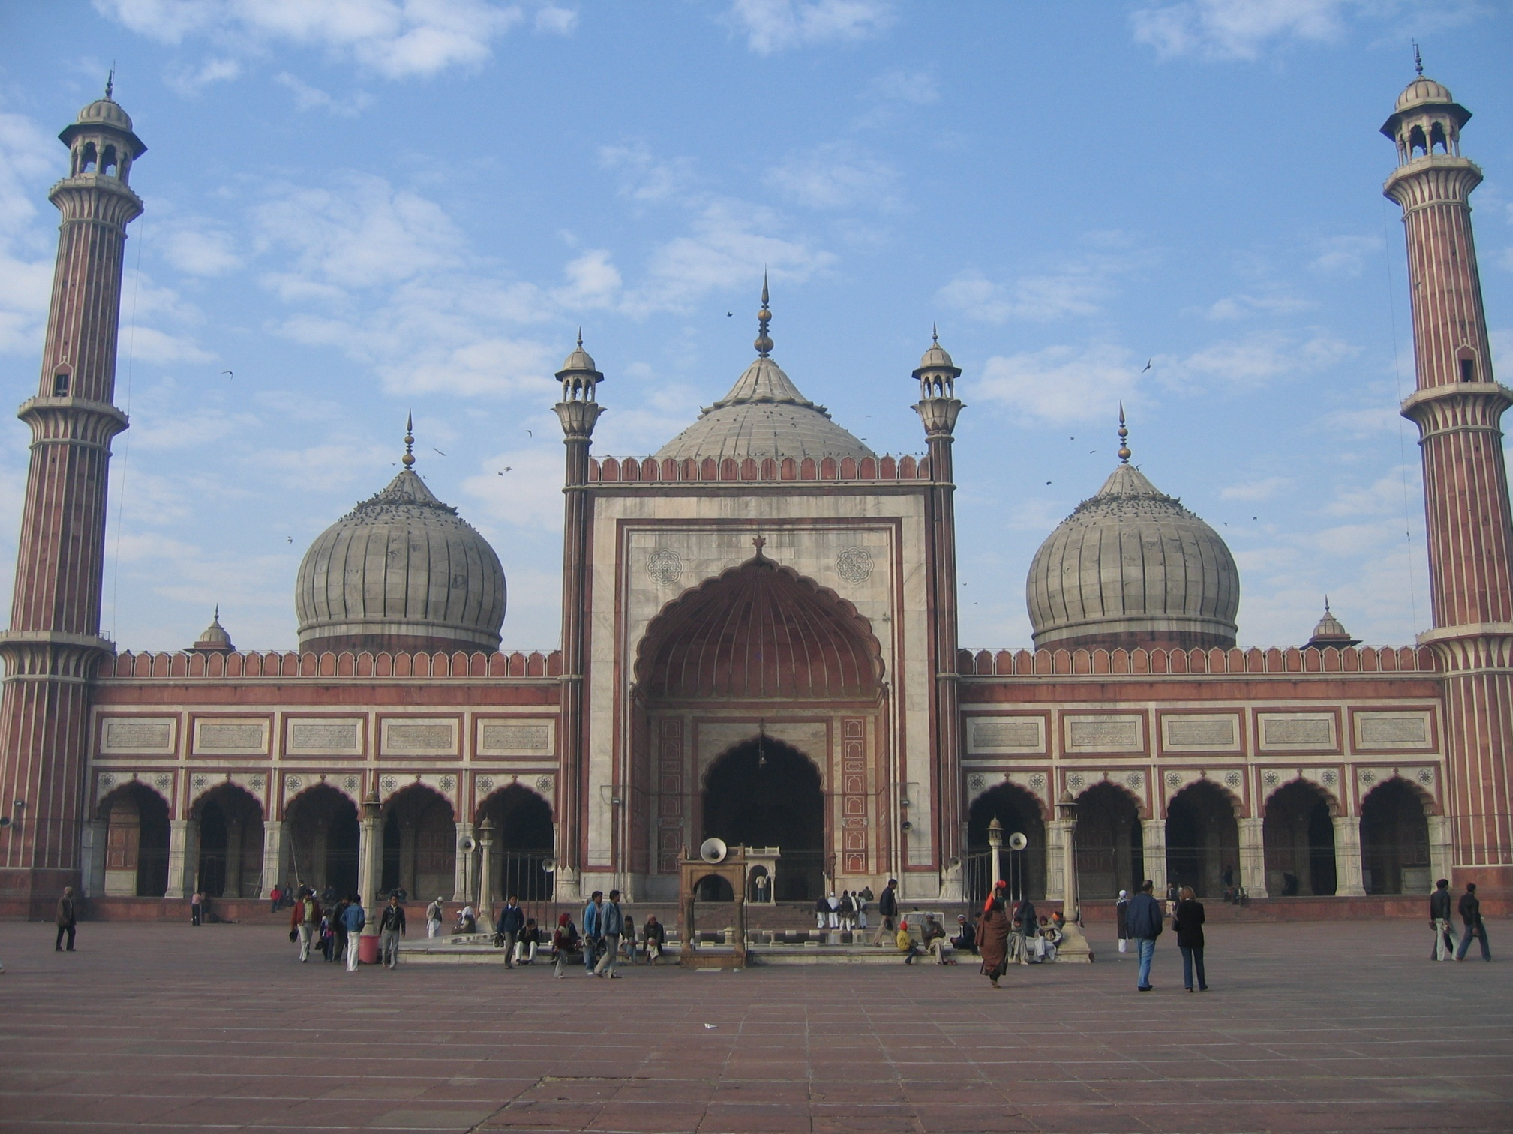

Slide 29
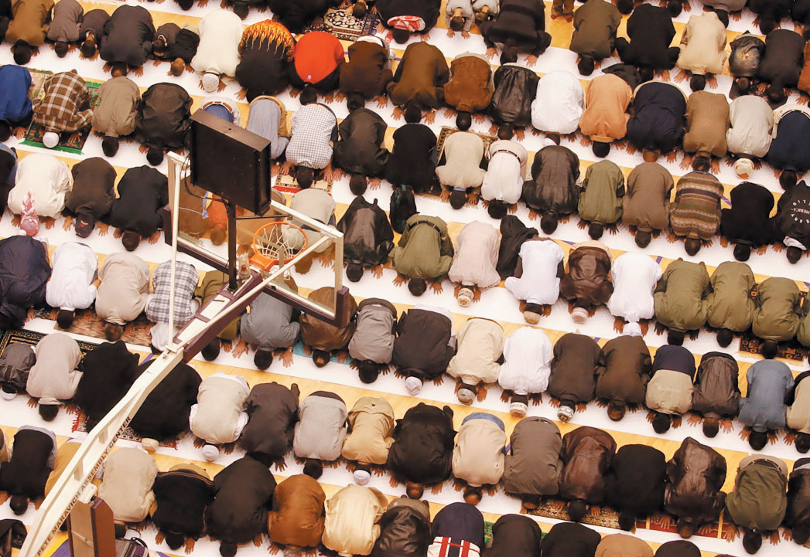
Prayer

Slide 30
