Slide 1
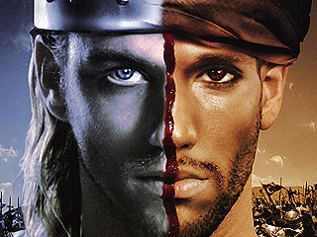

Slide 2
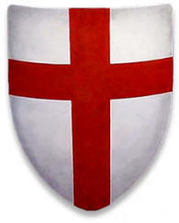
The Crusades
“War of the cross”

Slide 3
The Five W’s of The Crusades

Slide 4
Who?
Christian
Vs.
Muslims

Slide 5
What?
Wars Initiated by Christians to win back the Holy Land-Jerusalem- from the Muslims.
Jerusalem was controlled by the Muslims, Christians fought to take control.

Slide 6
Where?
Jerusalem

Slide 7
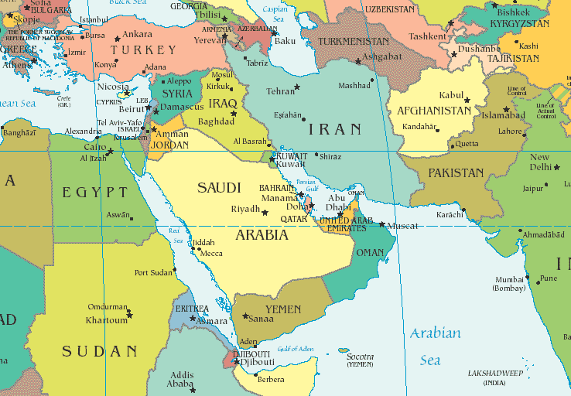

Slide 8
Why?
Jerusalem was very important to both Christians and Muslims.
Jerusalem was considered to be the Holy Land for both Religions.
Christian Importance: Jesus born near by, Lived most of his life in Jerusalem, and Crucified (died) there.
Muslim Importance: Muhammad spent a lot of time there.

Slide 9
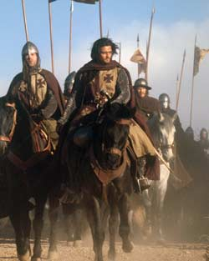
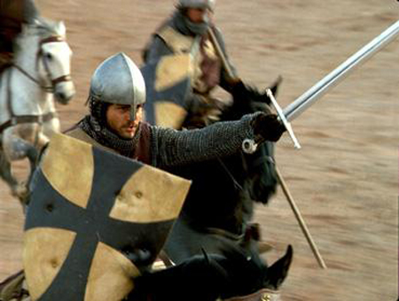
When?
1076 a.d.

Slide 10
How?
Christians, called “Crusaders,” made long trips from England to Jerusalem, at the request of the King, to fight the Muslims in an attempt to take back control of Jerusalem.

Slide 11
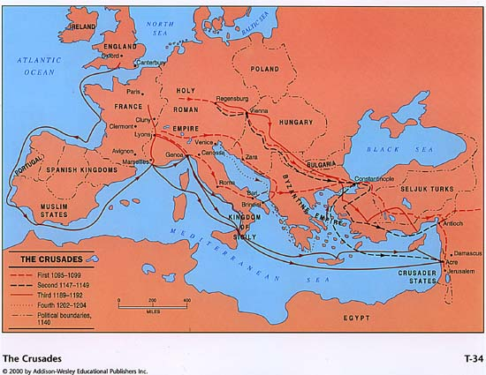

Slide 12
Propaganda of the Crusades
Urban appealed to the knight's religious convictions
Urban said Muslim Turks were robbing and torturing Christian pilgrims journeying to the holy land.
The war offered knights a chance for glory and wealth.
Urban suggested the knights fight Muslims instead of continuing to fight one another.

Slide 13
Results…
-Many people died.
-Muslims keep control of the Holy Land.

