Slide 1
Torture in the Medieval Times

Slide 2
11
Medieval Times Torture PowerPoint
11
For material about Medieval Times torture devices

Slide 3
Definition of Torture
Method of inflicting pain

Slide 4
Why Torture?
Extract Confessions
Obtain names of other people
Get other info about the crime
Make them pay for crime

Slide 5
Location
Torture Chamber located in CASTLES
WHERE? Lower parts with winding hallways to muffle the screams

Slide 6
Problems with Torture
Innocent tortured
Innocent confess to end torture
NOT HUMANE—very painful
Torture Abolished: 1640

Slide 7
Methods
Ripping out teeth, nails, beating, blinding, boiling, bone-breaking, choking, cutting, whipping, flaying, roasting, starvation, drowning and TICKELING!

Slide 8
Torture as Humiliation

Slide 9
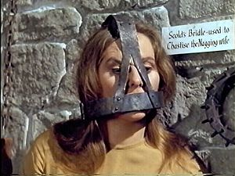
Brank
Humiliate women for gossiping, arguing.

Slide 10
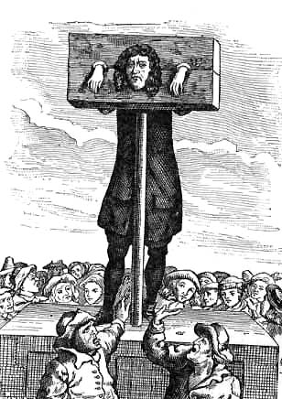
Pillory
Head and Arms stuck.

Slide 11
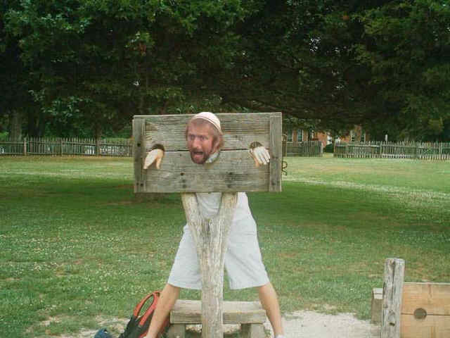
Stockades
Similar to Pillory, sometimes person is sitting.

Slide 12
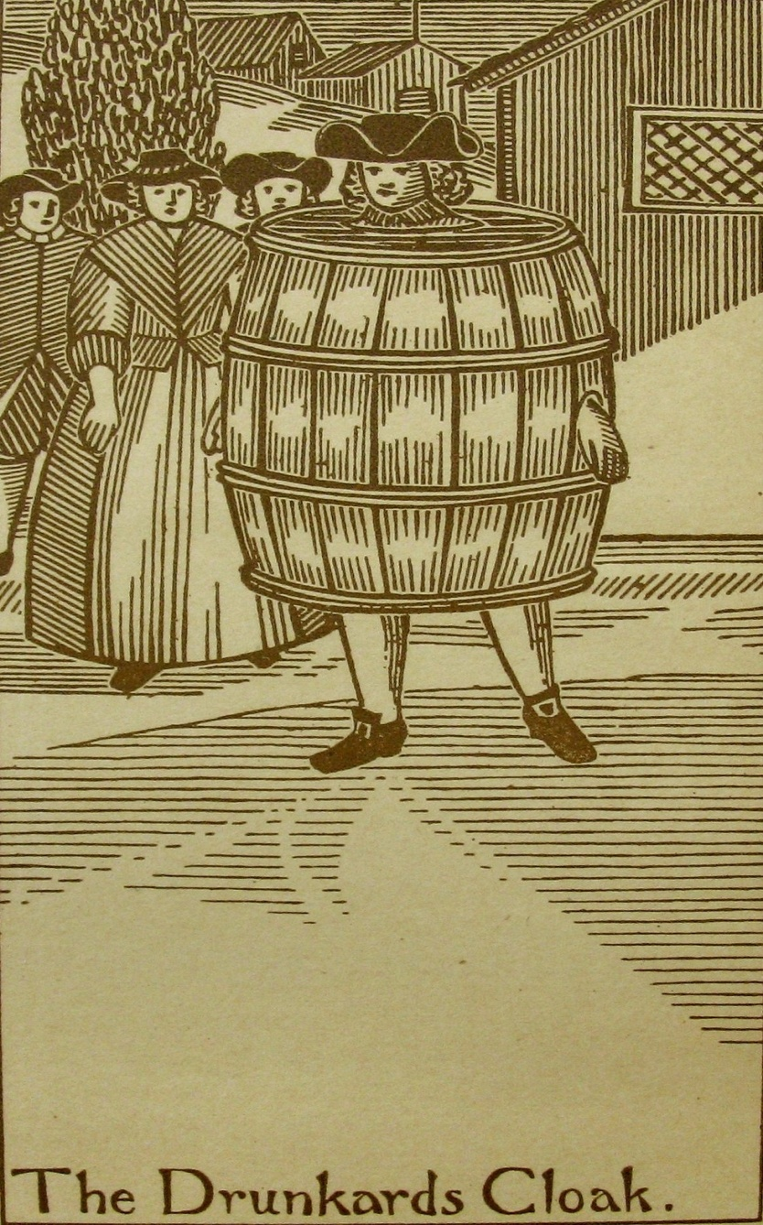
Drunkards Cloak
Barrel worn by person to show excessive drinking

Slide 13
Torture as Inflicting Pain

Slide 14
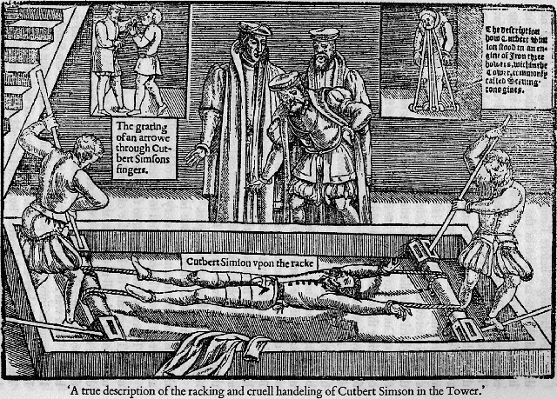
The Rack
Stretch the body

Slide 15
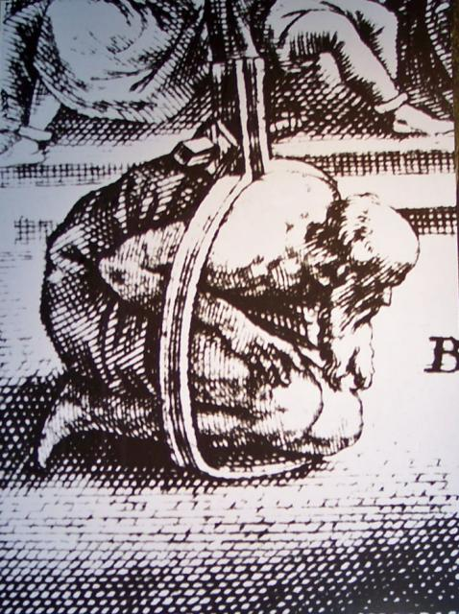
Scavengers Daughter
Opposite the Rack Squeeze the body

Slide 16
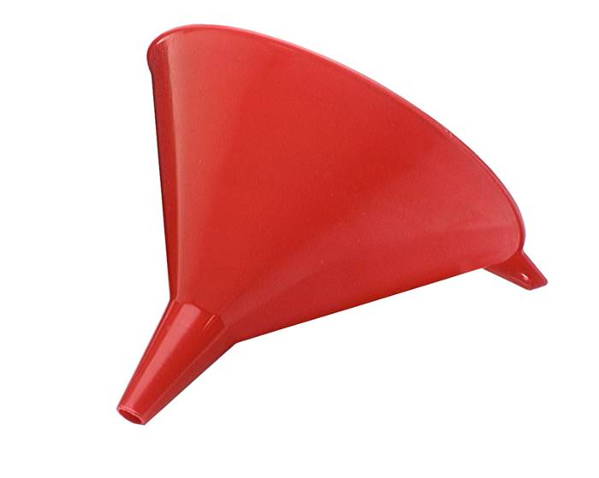
Water Torture
Force Water
Down the throat

Slide 17
Stockings of Parchment
Put feet in boots.
Boots get wet
Shrink

Slide 18
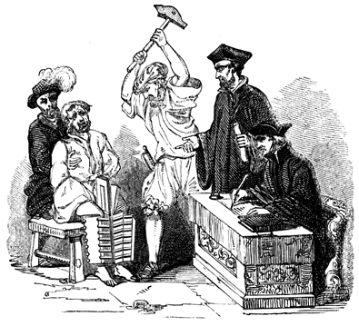
Iron Boot
Crush Feet

Slide 19
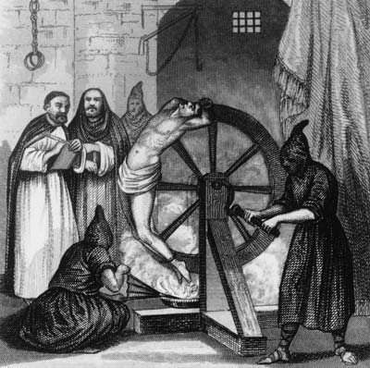
Wheel
Pass by fire
Or rolled down hill

Slide 20
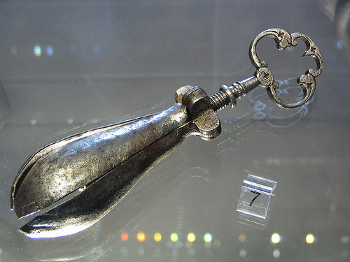
Pear of Anguish
Put down throat
And opened.

Slide 21
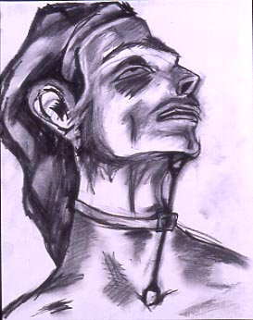
Heretic’s Fork

Slide 22
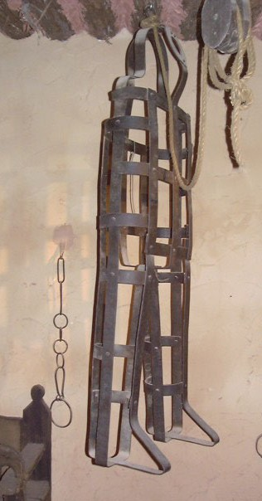
Coffin Torture
Person forced into a coffin

Slide 23
Torture as Execution

Slide 24
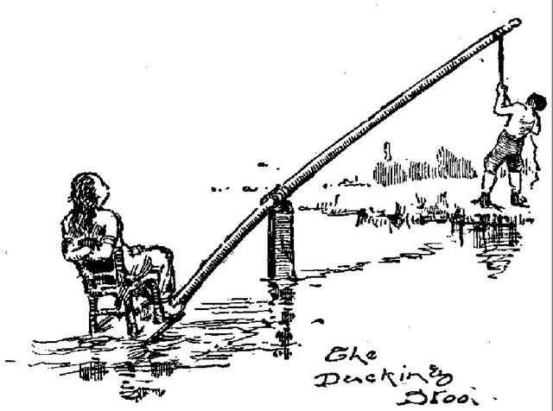
Ducking Stool

Slide 25
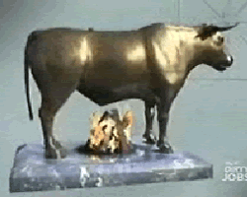
Brazen Bull

Slide 26
The Stake Quartering

Slide 27
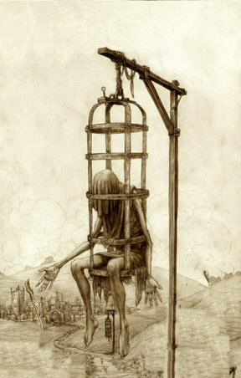
The Gibbet

Slide 28
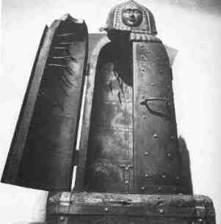
Iron Maiden

Slide 29
Why Learn about Torture?
Experience Each unit-talk about all aspects of culture, the good and the bad.
Make it clear why its called “Medieval Times” and “Dark Ages”

