Slide 1
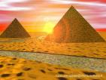

Slide 2
Egypt Main Ideas
Nile River
Pyramids
Mummification
Pharaohs
Gods and goddesses

Slide 3
General Information…
Life in Ancient Egypt Centered around:
Religion
Pharaoh
Family Life

Slide 4
Random, but important info
Egypt is a country. It is located on the continent of Africa
Modern Day Capital of Egypt: Cairo
Ancient Egypt is divided into 3 kingdoms.
Old Kingdom (2,700 B.C.E to 2,200 B.C.E). King Menes unites Upper and Lower Egypt around 3,100 B.C.E.
Middle Kingdom (2,100 BCE to 1,800 BCE) This time period is Egypt’s Golden Age.
New Kingdom (1500 BCE-1000 BCE).

Slide 5
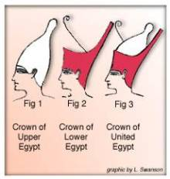
Uniting Upper and Lower Egypt
One of the most important event in Egyptian history occurred around 3,100 B.C.E.
King Menes United
Upper and Lower Egypt.
Signified by wearing
the double crown

Slide 6
MAP OF ANCIENT EGYPT
Fill in the Following Items on the map in your Ancient Egypt book. Use the link below:
Draw in the Nile River and label it
Label Giza
Label Cairo
Label Valley of the Kings
Label Mediterranean Sea
http://www.angelfire.com/ks/mbraman/images/egyptmap2.gif

Slide 7
Nile River
Gets its name from Greek word “Nelios” meaning “River Valley”
Length: 4184 Miles***
Source: Lake Victoria, Uganda

Slide 8
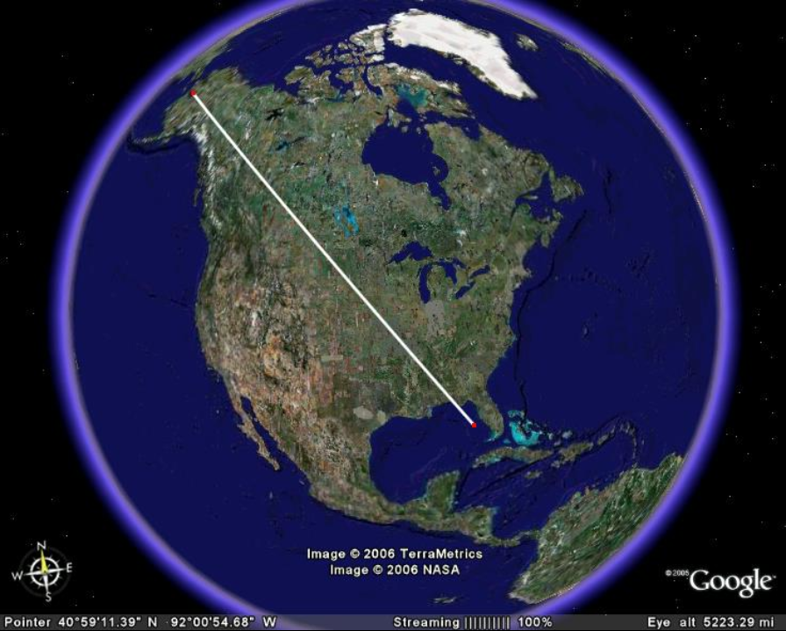

Slide 9
The Nile River

Slide 10
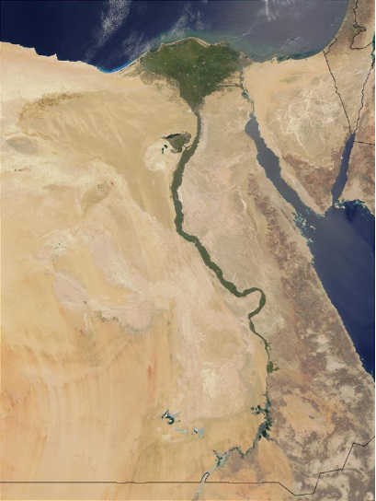
Upper Egypt***
Lower Egypt***

Slide 11
Black Land
Fertile Land
Located right along the Nile River
This land is fertile because of the annual flooding of the Nile. It leaves behind many nutrients

Slide 12
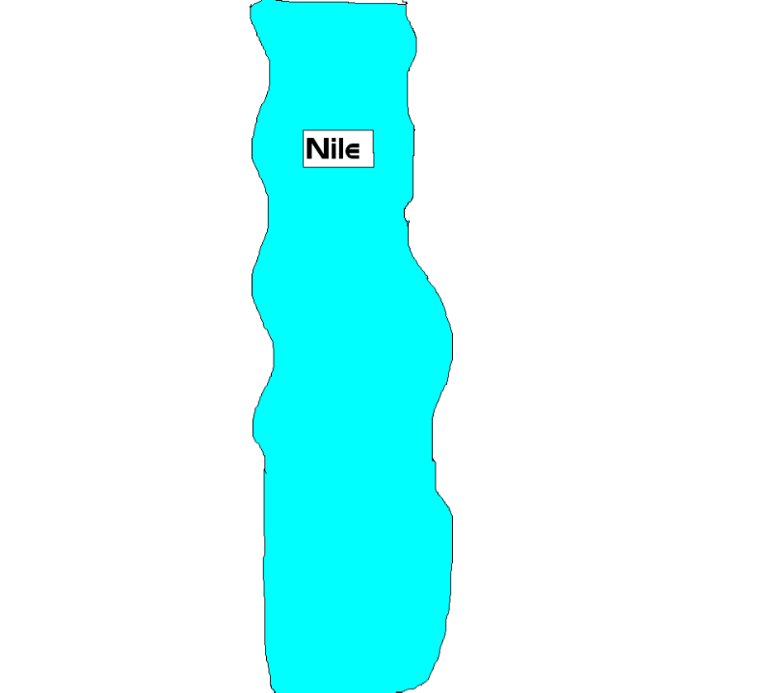

Slide 13
Red Land
All Desert
No crops could grow here because no water reaches this area

Slide 15
Giver of Life
Egyptians are only able to survive in this area because of the Nile.
Provides nearly everything they need to survive.
Irrigated Land for farming
Transport Goods
Provided Food

Slide 16
Taker of Life
Despite all of the benefits of the Nile, it’s flooding is also capable of killing crops and taking human lives
Overflow too much—destroyed Crops; Killed people
Overflow too little—Crops could not grow;
Overcome this problem and able to survive by using surplus of food and resources

Slide 17
Religion
Egyptian life was centered around their religious beliefs.
Pharaohs directed daily lives of the Egyptians
The cat was holy to Ancient Egyptians
The ancient Egyptians believed that cats had magical powers. They believed cats protected their homes and children from danger. They kept a cat for protection.
Egyptians were polytheistic
Their main god is the sun god named Amon-Ra, Re, or Ra.

Slide 18
Pharoahs
Leaders in Ancient Egypt were called Pharaohs
Pharaohs were considered god-kings. They were thought to not only be the kings, but were thought to be of a higher power, and not of a human kind.
Pharaohs were often mummified upon their death

Slide 19
Pharaohs Continued
Using the websites provided for you, answer the following questions.
Click here to complete the following activity.
**Click on the Name of the Pharaoh to find information about them.
**For each Pharaoh selected, list AT LEAST TWO (2) facts about them.

Slide 20
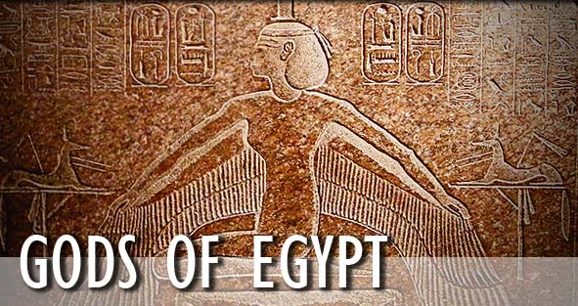
Gods and goddesses

Slide 21
Gods and Goddesses of Ancient Egypt
Click here to complete the activity
Using the link above, write down AT LEAST SIX (6) gods or goddesses.
**Things to include**
-Name of the god/goddess
-What they are the god of

Slide 22
Egyptian Beliefs
Ancient Egyptian gods and goddesses rose out of a need to:
explain the mysteries of nature
Explain their creation
Develop a religion.
Please the gods=peace and prosperity across the land

Slide 23
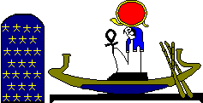
Ra, ALSO KNOWN AS Re
Red circle
Sun god
Most important god

Slide 24
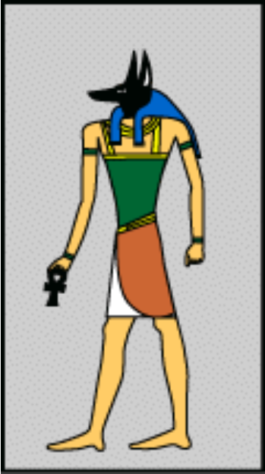
Anubis
God of mummification
Jackal headed mask

Slide 25
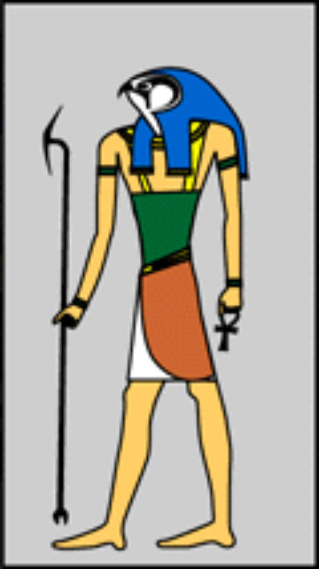
Horus
Man with the head of a hawk or falcon
God of the sky
Protector of the ruler of Egypt

Slide 26
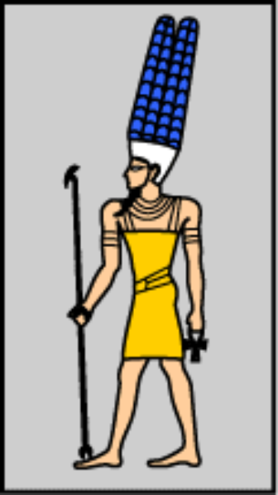
Amun
Man with a ram head
One of the most powerful gods
At one point in Egyptian history, he was considered the “king of the gods”
Combined with Ra to be even more powerful=Amun-Ra

Slide 27
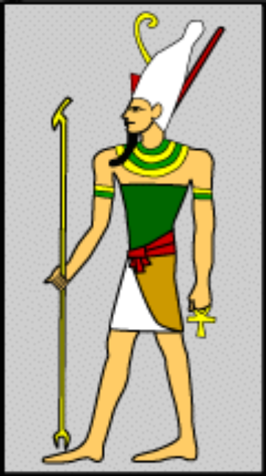
Atum
Man with the double crown
Creator god
First god to exist on earth

Slide 28
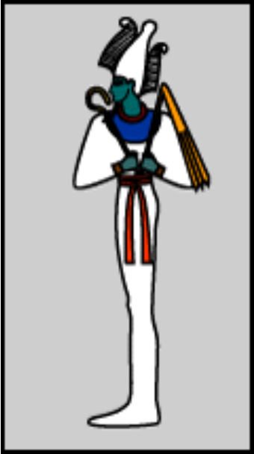
Osiris
A mummified man wearing a white cone-like headdress with feathers
God of the dead and underworld
Gift of barley

Slide 29
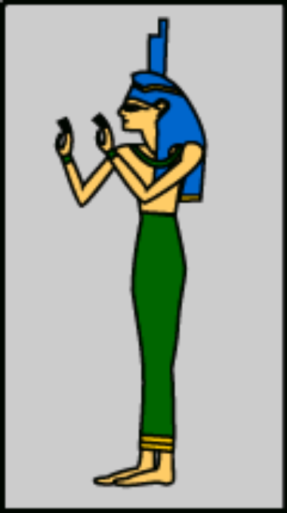
Isis
Woman with headdress in the shape of a throne
Protective goddess

Slide 30
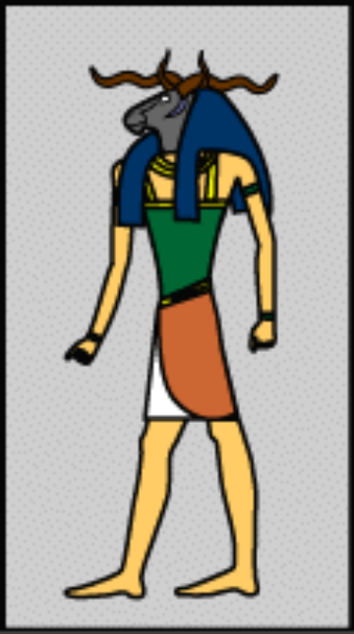
Khnum
Man with the head of a curly-horned ram
God of flooding

Slide 31
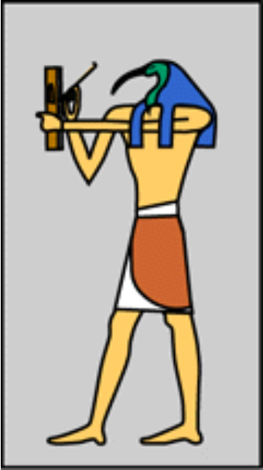
Thoth
A man with the head of an ibis holding a writing palette
God of writing and knowledge
Gave the Egyptians the gift of Heiroglyphics

Slide 32
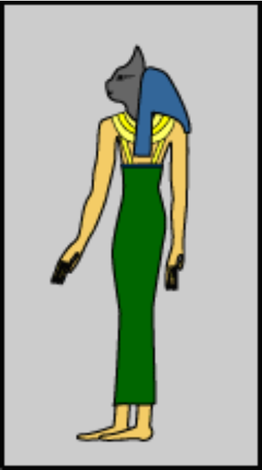
Bastet
Woman with the head of a cat
Protective goddess

Slide 33
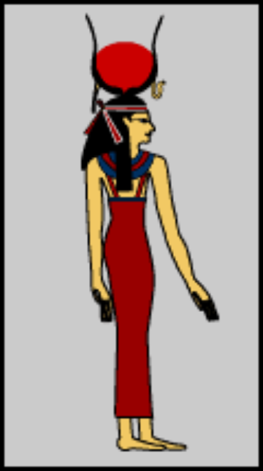
Hathor
Woman with a headdress of horns and a sun disk
Goddess of love and joy
Mother of the pharaoh

Slide 34
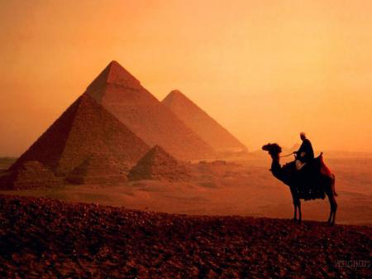
Pyramids

Slide 35
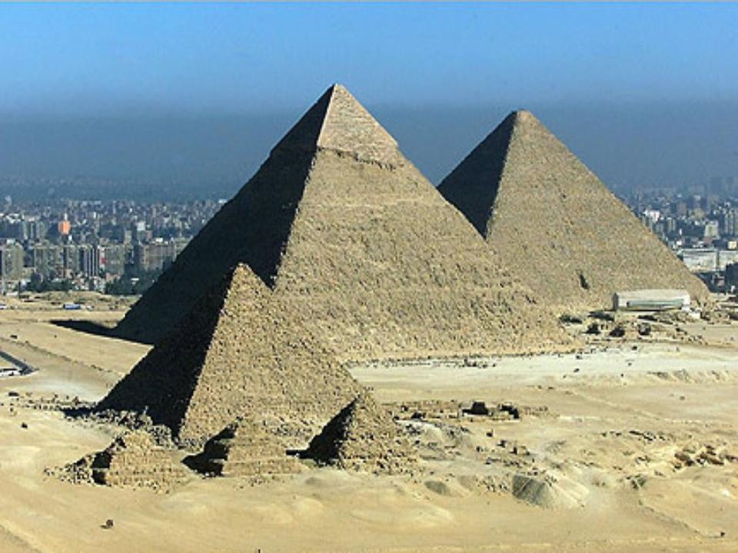
Pyramids

Slide 36
Pyramids
In ancient Egypt, Pyramids were built as tombs for the Pharaohs.
Most Pyramids in Egypt were built during the Old Kingdom
First Pyramid built in ancient Egypt was a Step Pyramid for the Pharaoh Djoser.
Great Pyramid and Sphinx located at Giza

Slide 37
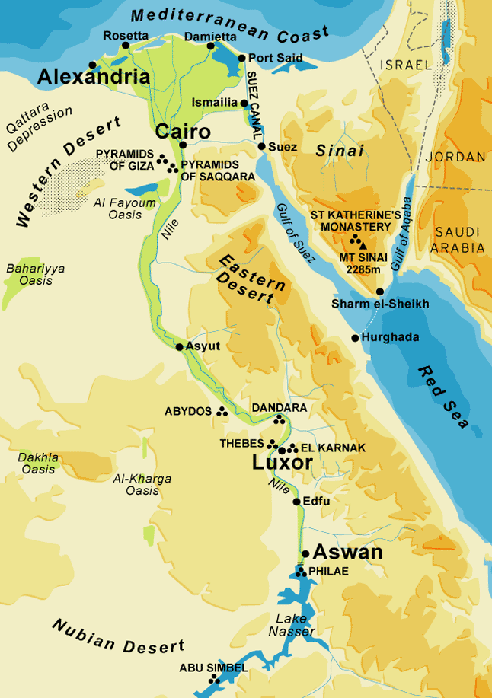
Where is Giza

Slide 38
Giza Complex

Slide 39
Giza Complex

Slide 40
4 Main structures at Giza
Sphinx
Pyramid of Menkaure
Pyramid of Khafre
Pyramid of Khufu

Slide 41
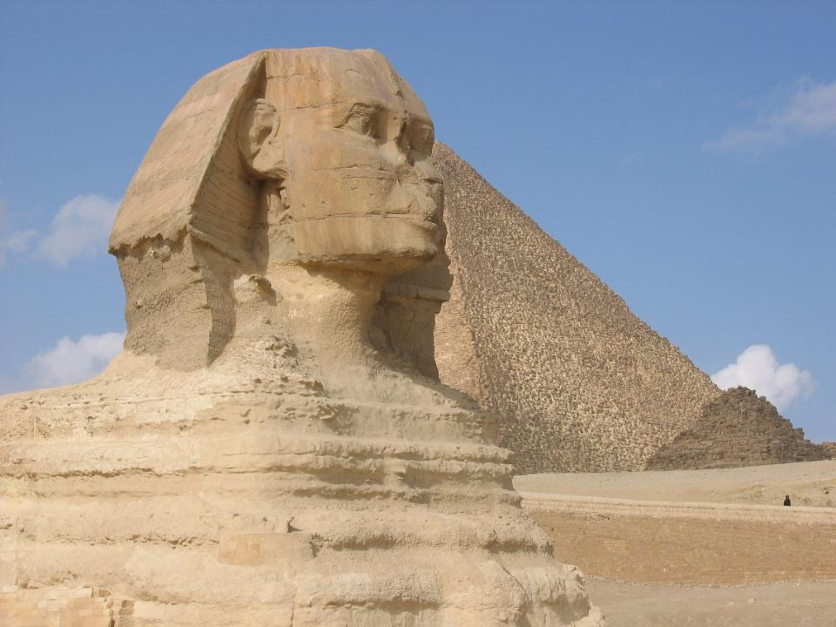
The Great Sphinx

Slide 42
Great Sphinx **“Guardian of the Giza Complex”**
**The largest single stone statue on Earth
**Built in 3,000 b.c.e
**Body of a Lion; Head of a Man
**Limestone

Slide 43
Great Sphinx
Giza Necropolis abandoned: desert sands blow in. Sphinx becomes buried up to its shoulders
1925: Sphinx finally dug out completely
Missing Nose: Some scholars think it was shot of in a war, others believe it was knocked off by an angry King

Slide 44
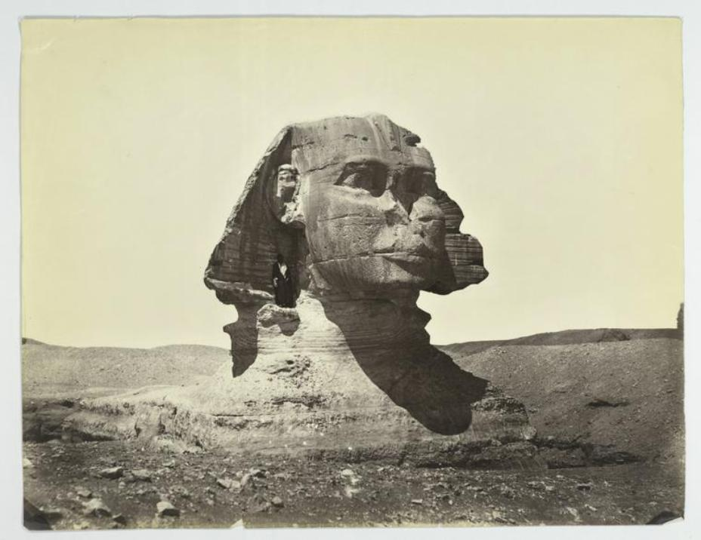

Slide 45
Pyramid of Menkaure
**Smallest of the Three
**Limestone and Granite
Unique: Archaeologist found a beautiful sarcophagus in the Pyramid
Now it lays at the bottom of the Mediterranean Sea…

Slide 46
Pyramid of Khafre

Slide 47
Pyramid of Khafre
**2nd Largest Pyramid
-Steep Sides and Higher ground make it appear as if it’s bigger
-Blocks weighed 2.5 tons
**Unique: Still retains some of it’s smooth limestone casing at the top

Slide 48
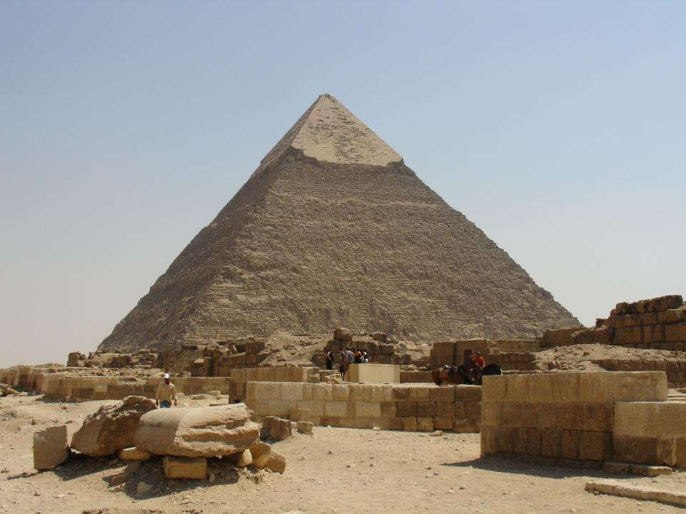

Slide 49
The Great Pyramid

Slide 50
**Pyramid of Khufu**
Largest Pyramid of Giza
World tallest building for 1,270 years
**Near the Great Pyramid
**3 small pyramids for his wives
**Small tombs for his nobles
Town for workers: cemetery, bakery, factory, copper melting complex

Slide 51
Pyramid of Khufu
Materials and Workforce
**Roughly 23 year period
**Paid workers
-Over 2 Million Blocks
-Each blocked weighed roughly 2 tons
=
**6 Million Ton Pyramid
(12,000,000,000 pounds)

Slide 52
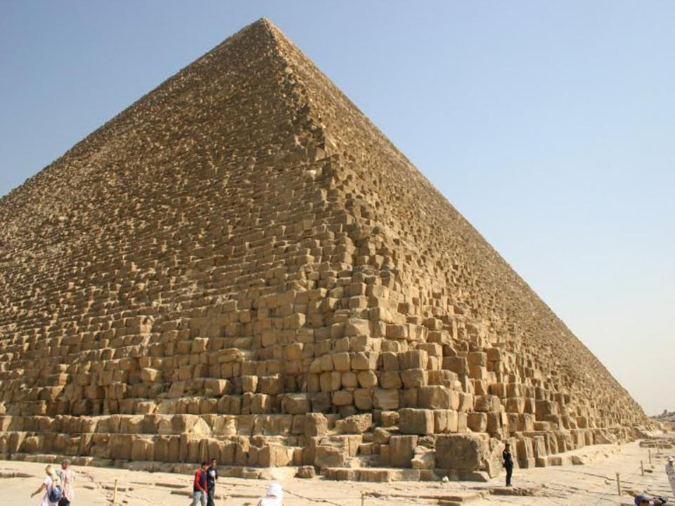

Slide 53
How the Pyramids were Built
https://www.history.com/embed/21128150

Slide 54
Build a Pyramid Game
Play only once during this web quest. I will give you more time when you are done to play numerous times. You can always play at home.

Slide 55
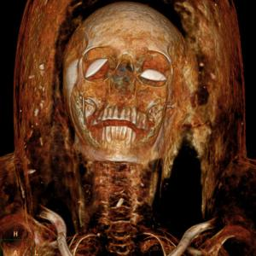
Egyptian Mummification

Slide 56
Mummy Facts
There were over 70 million mummies.
They disappeared because of plundering of grave robbers for riches.
Mostly Pharaohs and relatives were mummified
Mummies were married to Duddies – ha ha I crack myself up!!!!

Slide 57
Drying out a dead body to prevent it from rotting

Slide 58
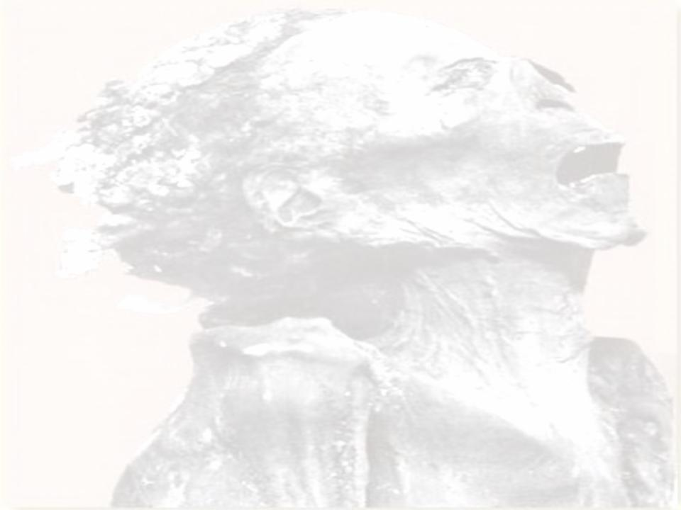
Mummification
Having your body mummified was very EXPENSIVE

Slide 59
Why The Need To Mummify?
1. Physical Body need to be preserved
2. Ensure a Safe Passage to the afterlife
3. King mummified so spirit would Recognize him in the afterlife.

Slide 60
Process of Mummification

Slide 61
1. Announcement of Death
Messenger Sent out to the streets to announce the death.

Slide 62
2. Embalming the Body
Dead body brought to special tent for embalming (preparations)

Slide 63
3. Removal of Brain
Egyptians thought brain was a Waste of space.
Method 1: Remove brain through the nose with a hook
Method 2. Mix up brain with wire and let it drain out through nose

Slide 64
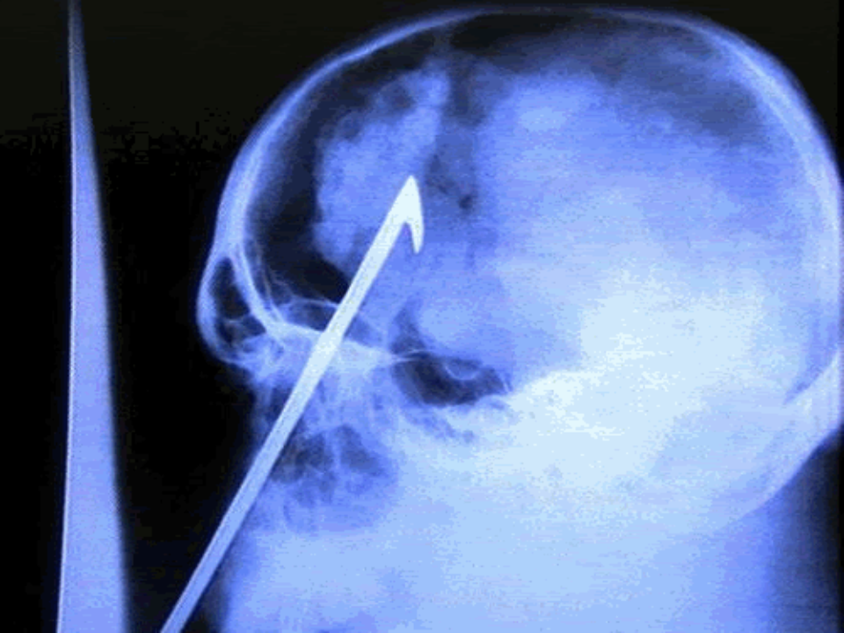

Slide 65
4. Removal of Internal Organs
Liver
Lungs
Stomach
Intestines
-Method: small slit cut in stomach and organs pulled out.
**Organs then placed in Canopic Jars

Slide 66
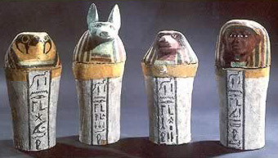
Canopic Jars

Slide 67
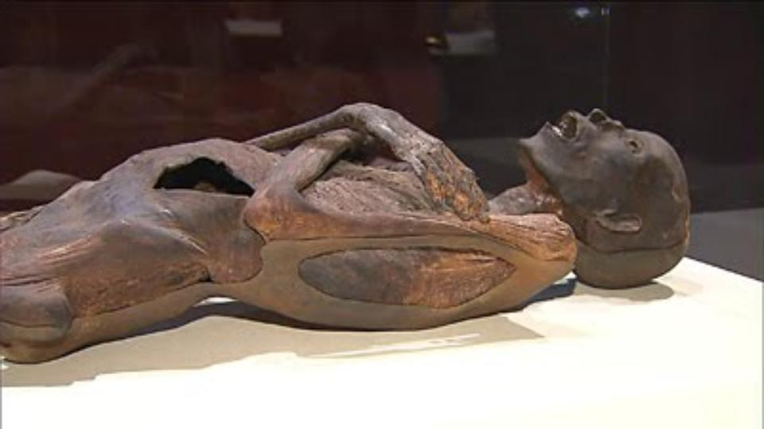

Slide 68
5. Drying out Process
Method: Body placed on slab and covered with Natron Salt
40 Days

Slide 69
6. Wrapping the body
Very difficult process
Used Hundreds of Yards of Linen
Shroud added at end to keep wrappings together
Body covered with “Mummia” to glue everything together.
Body placed in sarcophagus

Slide 70
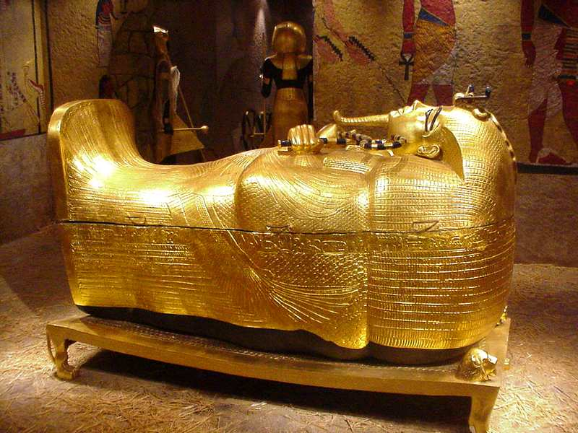
Sarcophagus of King Tut

Slide 71
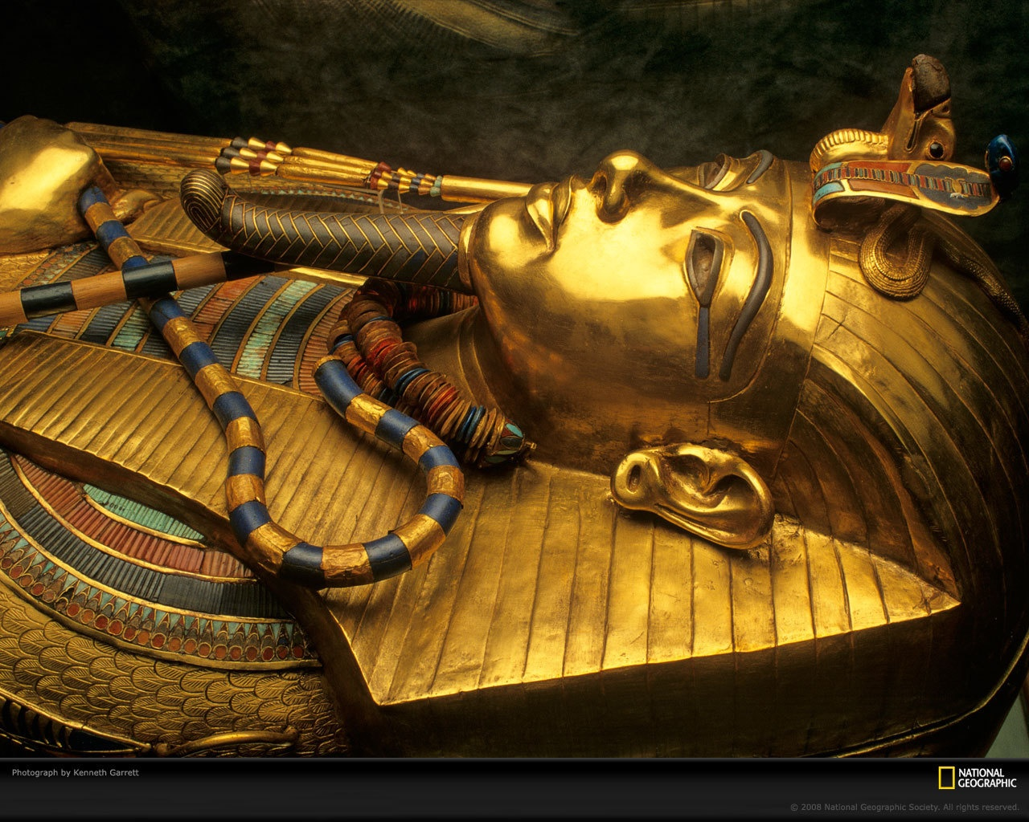

Slide 72
7. Final Procession
People were paid to cry to show the gods the person was well loved
The more people crying, the better chance of making it to the afterlife.

Slide 73
Ritual #1: Opening of the Mouth ***Gave the dead person the ability to see, hear, eat, and move in the afterlife***

Slide 74
Ritual #2: Weighing of the Heart - Heart is weighed against a feather…… -If Balanced: Soul is granted Immortality -If Heart Heavier: horrible fate

Slide 75
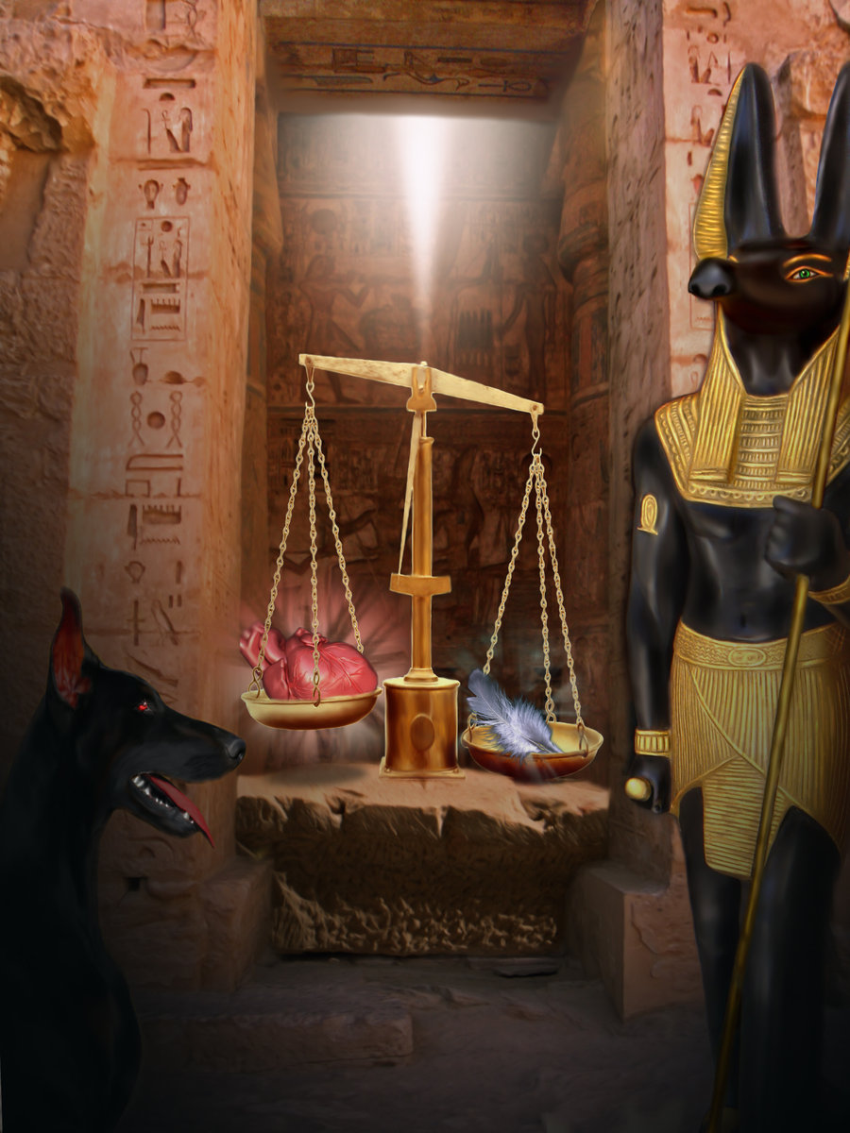

Slide 76
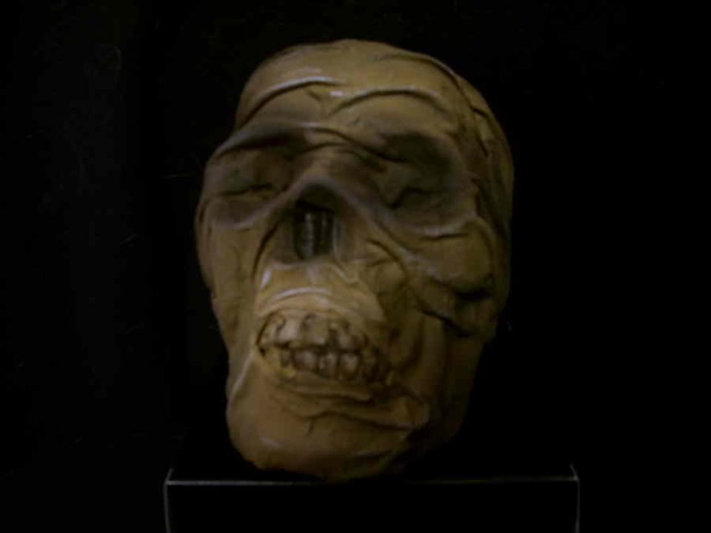

Slide 77
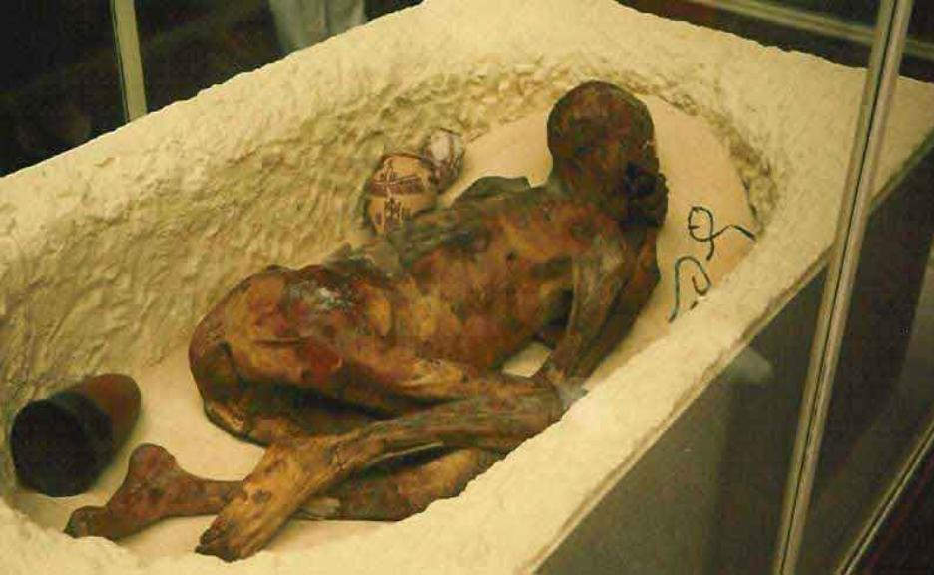

Slide 78
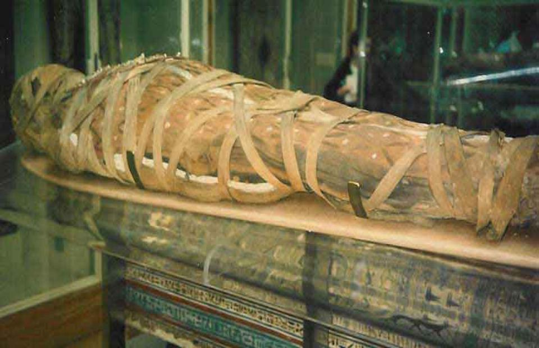

Slide 79
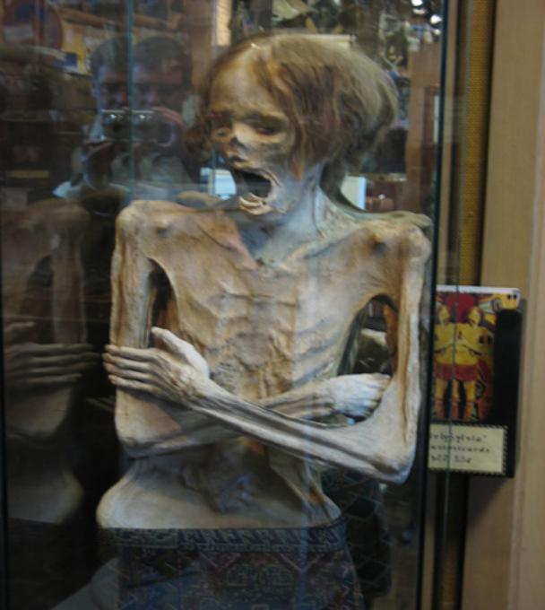

Slide 80
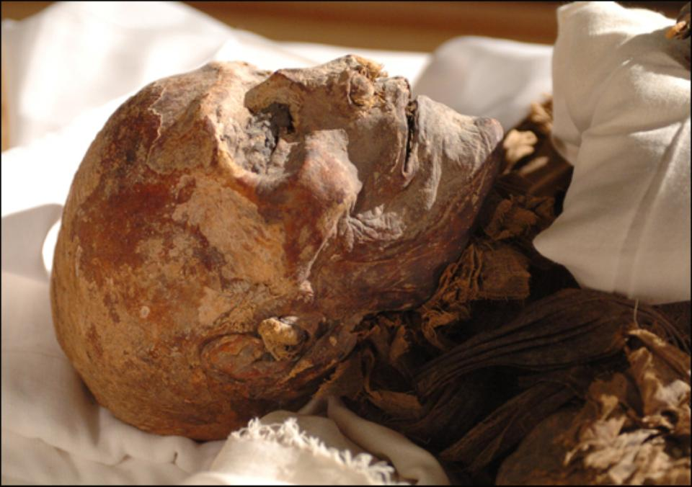

Slide 81
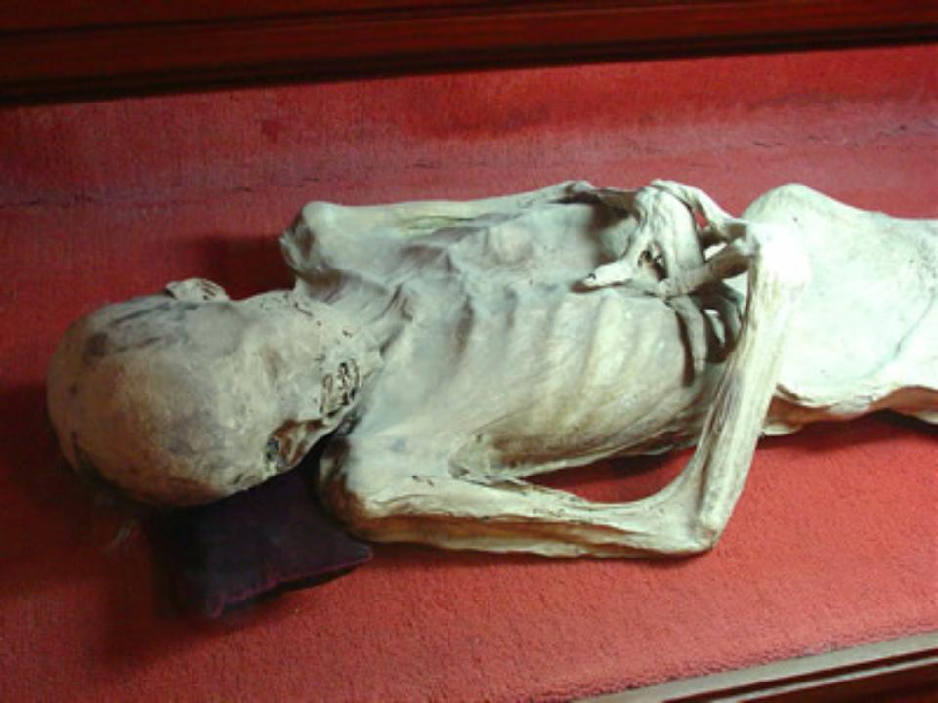

Slide 82
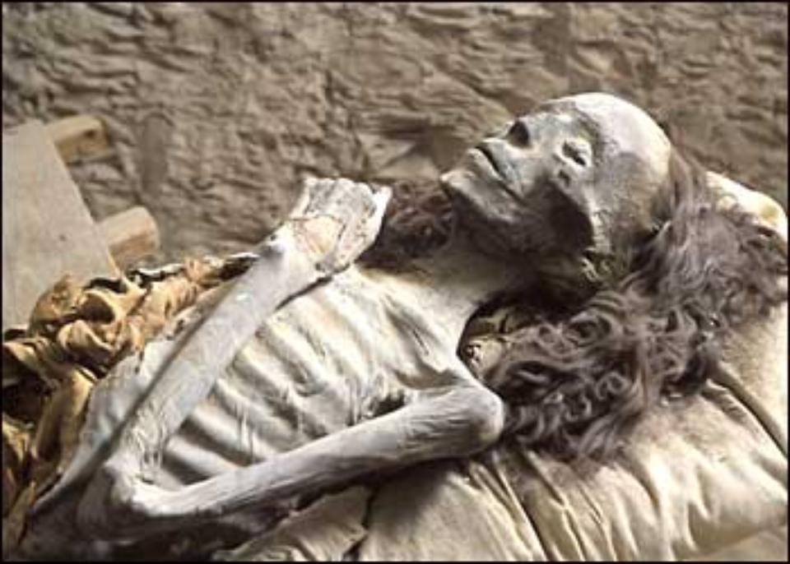

Slide 83
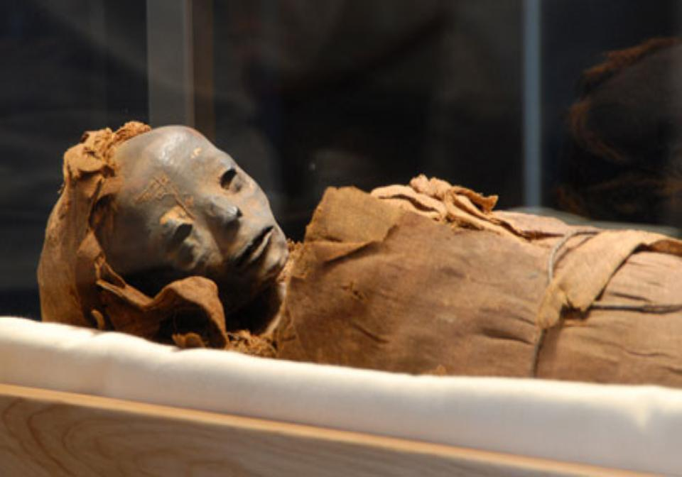

Slide 84
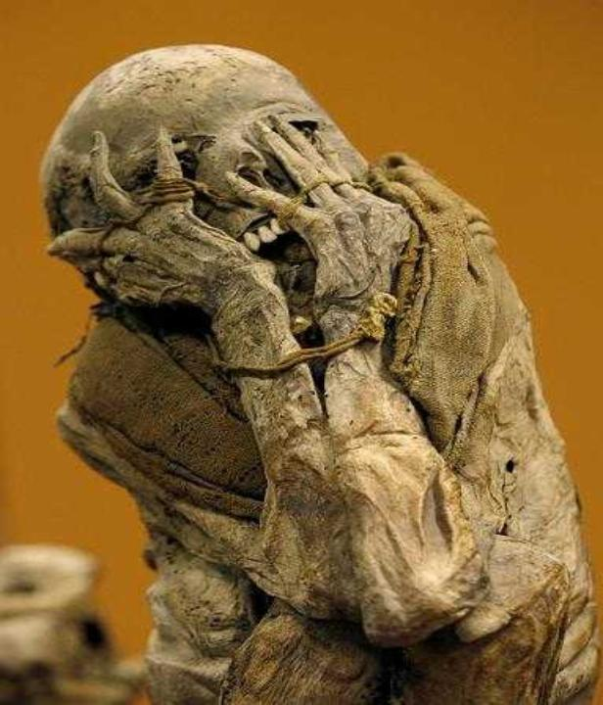

Slide 85
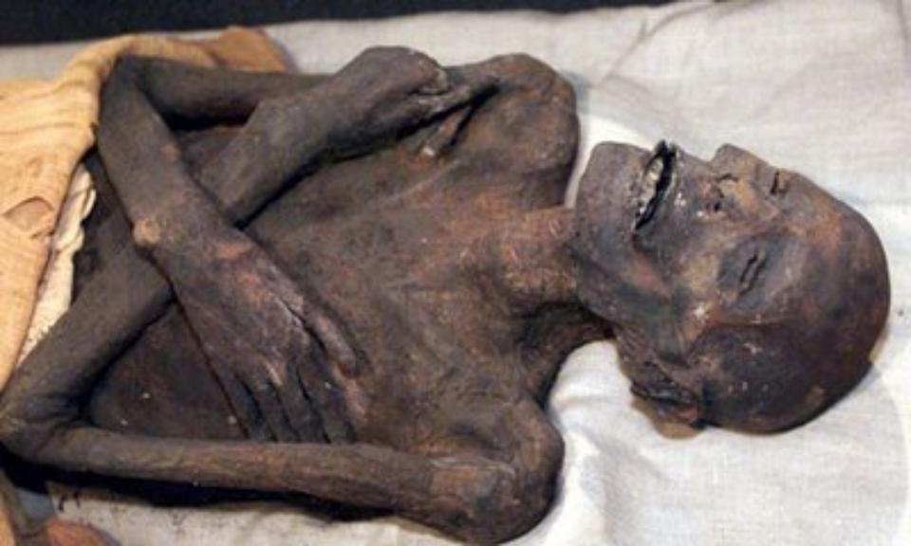

Slide 86
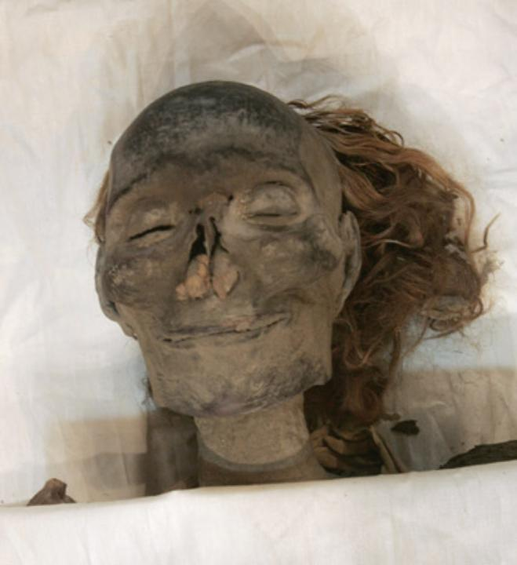

Slide 87
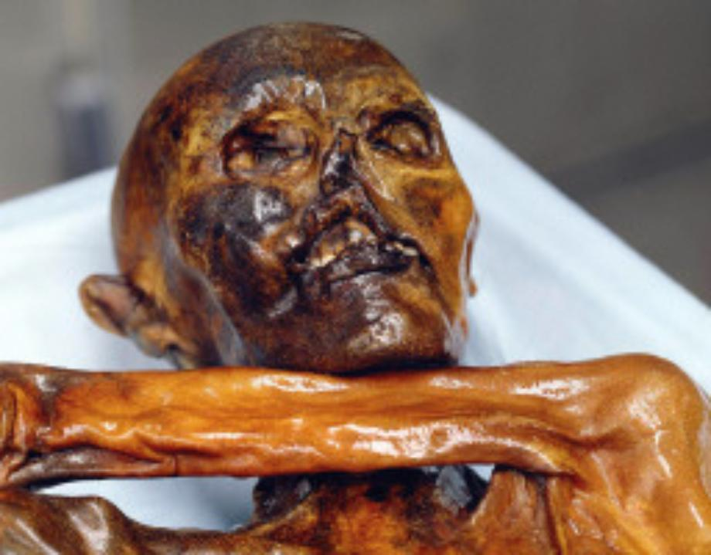

Slide 88
Mummies Game
Click on the link below to play the Mummies Game. Only play once. You will get more opportunities at the end.
Click to play game

Slide 89
HIEROGLYPHICS
Using the websites given to you, answer the following questions in your Ancient Egypt Book.
Write your First name and Last Name in Hieroglyphics using a list of Hieroglyphics
Then go to your “Ancient Writing” worksheet in your binder and copy it down again.

Slide 90
FAMILY LIFE
People of ancient Egypt highly valued family life.
Children were considered a great blessing.
The boys learned a trade or craft from their fathers.
Young girls received training at home from their mother
When parents died the son inherited the land, while the daughter inherited household goods.

Slide 91
GAME OF SENET
Click on link below to read the rules and play the game of Senet.
http://www.lutanho.net/play/senet.html

